Slide 1
Evaluating What Works: An Overview of Causal Methods for Policy Intervention and Service Evaluations
Presented by: Jamie Wong
Data Science Officer at NHS England & NCL ICB
PhD Student at UCL | Epidemiology, Data Science & Health Economics
Notes:
Standard title slide

Slide 2
Session Outline
The Role of Causal Methods in Enabling Data-Led Decision Making
Overview & Classes of Causal Methods
Quasi-Experimental Methods
Adjustment Based Methods
Case Studies from North Central London
Wrap-Up

Slide 3
The Role of Causal Methods in Enabling Data-Led Decision Making
Section 1
Notes:
Refer to section as challenges with data led decision making / enabling data led decision instead of causal inference.

Slide 4
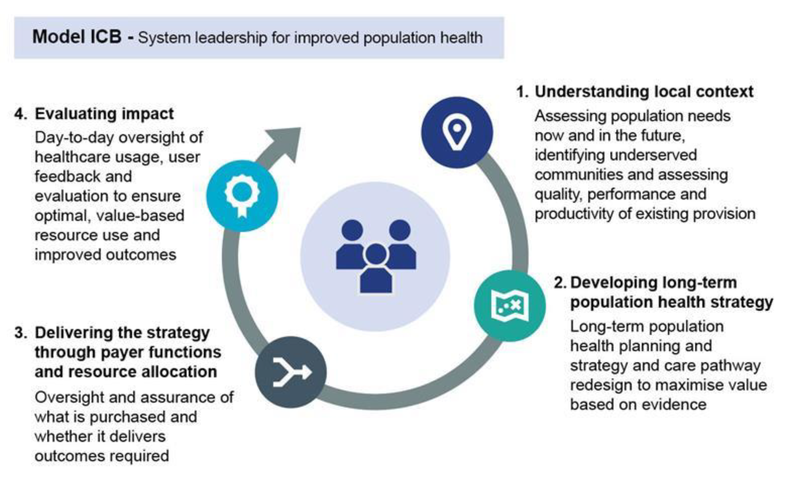
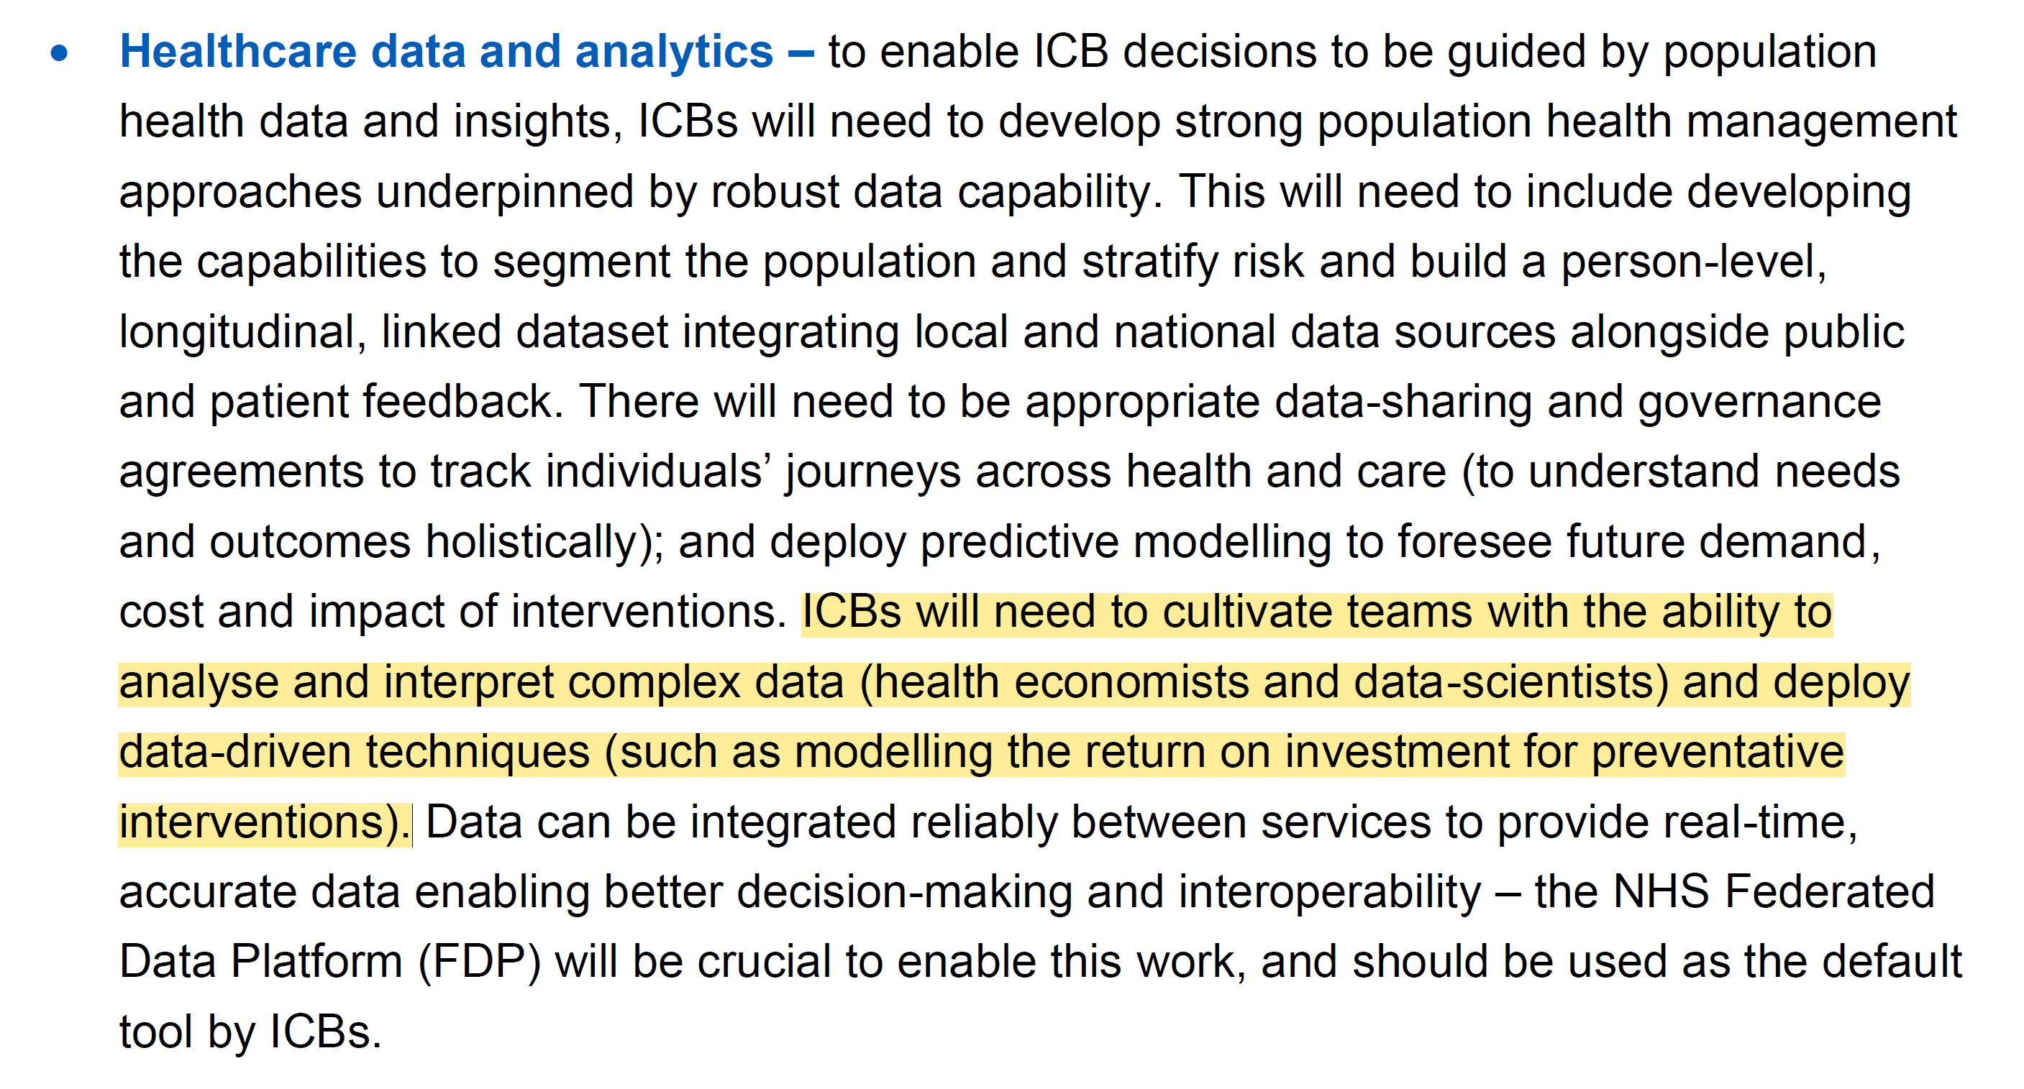
The 10 Year Plan & Model ICB Blueprint

Slide 5
Evaluation Questions of Interest
When performing evaluations of healthcare services or interventions, our questions are often framed in a causal manner:
Has our new breast cancer screening programme reduced mortality?
Did implementing a community-based model of care divert patients away from A&E services?
Did implementing a hub and spoke model reduce clinical harm and lower patient waiting times?
Notes:
Plain slide with subhead and bullets

Slide 6
Why Current Evaluation Methods Can Be Misleading
And yet, we often fully attribute changes in descriptive statistics to specific changes in policy through creating and using:
Data dashboards
Time series charts
Raw proportions or means
None of which account for underlying trends or confounding factors.
Notes:
Plain slide with subhead and bullets

Slide 7
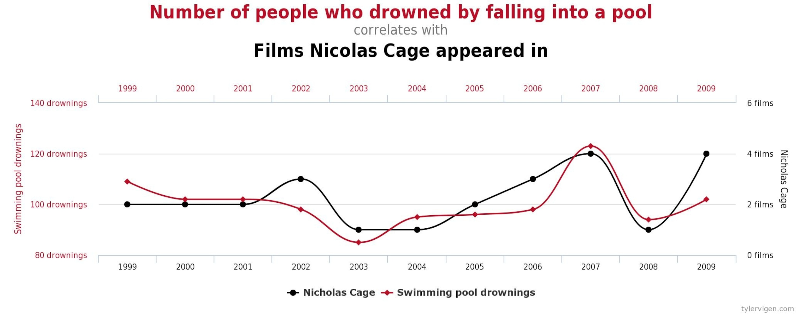
Correlation ≠ Causation
Notes:
Make it clear that’s there two types of non-causal associations:
- Random associations vs uncontrolled confounding

Slide 8
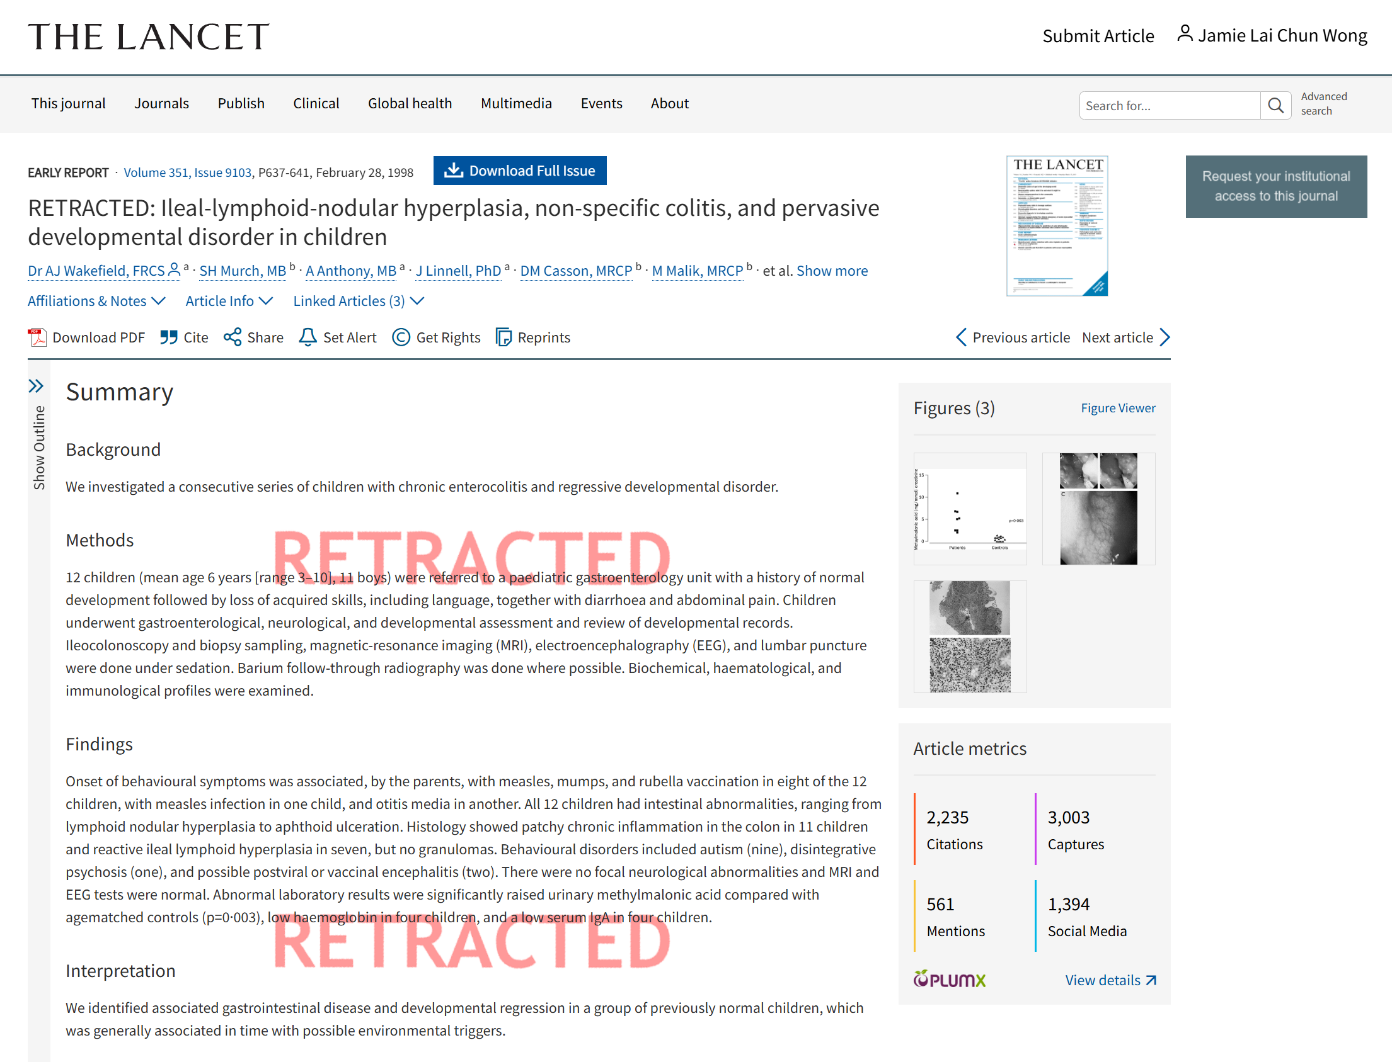
When Correlations Can Be Misleading
Notes:
Make it clear that’s there two types of non-causal associations:
- Random associations vs uncontrolled confounding

Slide 9
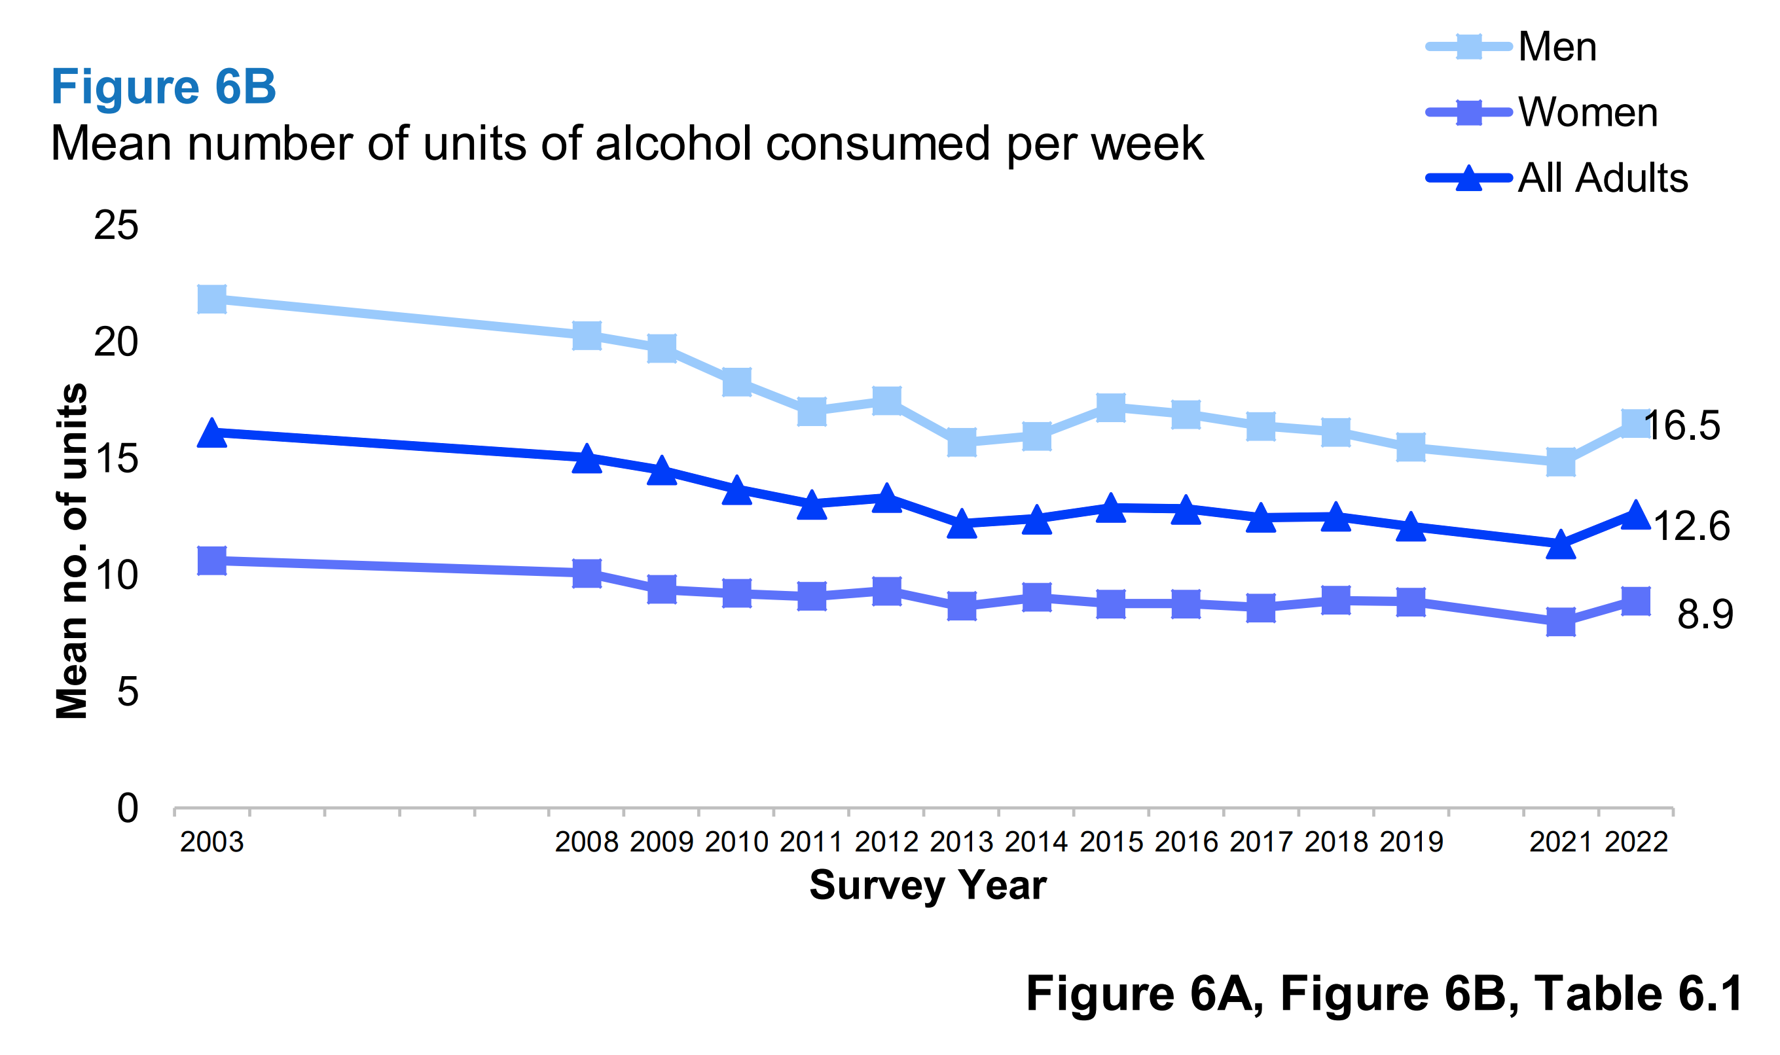
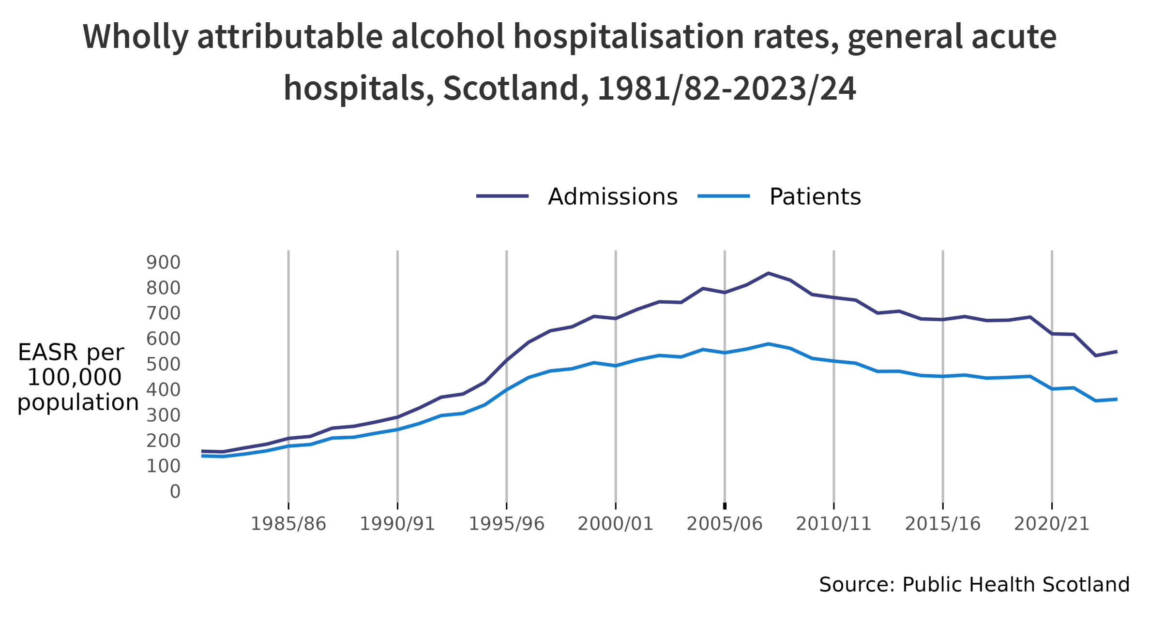
Example: Minimum Pricing of Alcohol in Scotland
Scotland introduced a statutory minimum price for alcohol (50p per unit) in May 2018.
Time series plots indicate that both alcohol consumption and alcohol hospitalisation rates decreased after implementing the intervention.
Birtwistle, S. et al. (2022) The Scottish Health Survey 2022 – Volume 1: Main Report. Scottish Centre for Social Research. Available at: https://www.gov.scot/publications/scottish-health-survey-2022-volume-1-main-report/pages/10/ (Accessed: 5 August 2025).
Public Health Scotland (2024) Alcohol consumption and harms dashboard 2023/2024. Available at: https://publichealthscotland.scot/publications/alcohol-consumption-and-harms-dashboard/alcohol-consumption-and-harms-dashboard-20232024/ (Accessed: 5 August 2025).
Notes:
Plain slide with subhead and bullets

Slide 10
Was the intervention successful?
Maybe, though there are a multitude of reasons for the decrease following 2018, for example:
The intervention caused the drop in alcohol hospitalisation rates through lowering alcohol consumption
The perceived effect of the intervention was, in fact, due to the pre-existing downward trend of alcohol consumption
Economic conditions might have reduced alcohol purchasing independent of the intervention
Birtwistle, S. et al. (2022) The Scottish Health Survey 2022 – Volume 1: Main Report. Scottish Centre for Social Research. Available at: https://www.gov.scot/publications/scottish-health-survey-2022-volume-1-main-report/pages/10/ (Accessed: 5 August 2025).
Public Health Scotland (2024) Alcohol consumption and harms dashboard 2023/2024. Available at: https://publichealthscotland.scot/publications/alcohol-consumption-and-harms-dashboard/alcohol-consumption-and-harms-dashboard-20232024/ (Accessed: 5 August 2025).

Slide 11
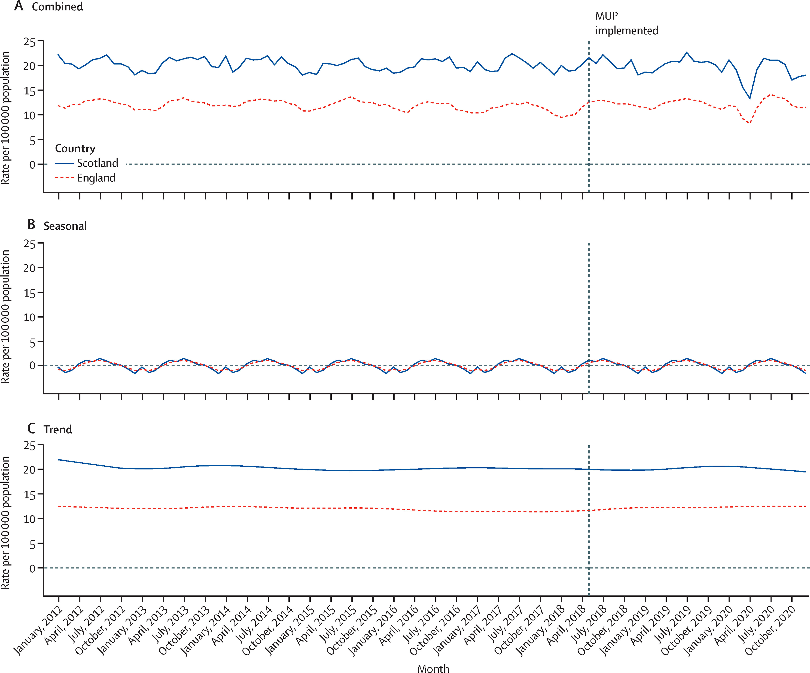
Figure 2 Rate of hospitalisations wholly attributable to alcohol consumption per 100 000 population by country
Empirically Quantifying Impact
By instead applying causal methods, we can control for trends and confounding factors, allowing us to:
Determine if the intervention caused our hypothesised outcome of interest
Quantify the magnitude of this effect (e.g., % reduction in hospitalisations) and our uncertainty of it
Conduct subgroup analyses to assess inequalities
Allows us to use these estimates in health technology assessments to estimate cost-effectiveness, thereby better informing future policy and commissioning decisions
*England was used as a control group in the study
“On average, and after 32 months, the implementation of alcohol MUP legislation was associated with a 4·1% decrease (95% CI –8·3 to 0·3; p=0·064) in hospitalisations wholly attributable to alcohol consumption.”
“The largest reductions were estimated in the 40% most socioeconomically deprived areas in Scotland, indicating that the implementation of MUP has had a positive impact in tackling deprivation-based health inequalities in alcohol health harms.”
Wyper, G.M.A. et al. (2023) ‘Evaluating the impact of alcohol minimum unit pricing on deaths and hospitalisations in Scotland: a controlled interrupted time series study’, The Lancet, 401(10385), pp. 1361–1370. Available at: https://doi.org/10.1016/S0140-6736(23)00497-X.
Notes:
-Add in more descriptive titles throughout
-Consider section on inequalities from the paper

Slide 12
Overview & Classes of Causal Methods
Section 2

Slide 13



Fundamental Problem of Causal Inference
Notes:
Plain slide with subhead and bullets

Slide 14

Fundamental Problem of Causal Inference
Notes:
Plain slide with subhead and bullets

Slide 15



Randomizing for Exchangeability
Participant characteristics should be evenly distributed between both groups
Notes:
Hence randomized controlled trials

Slide 16
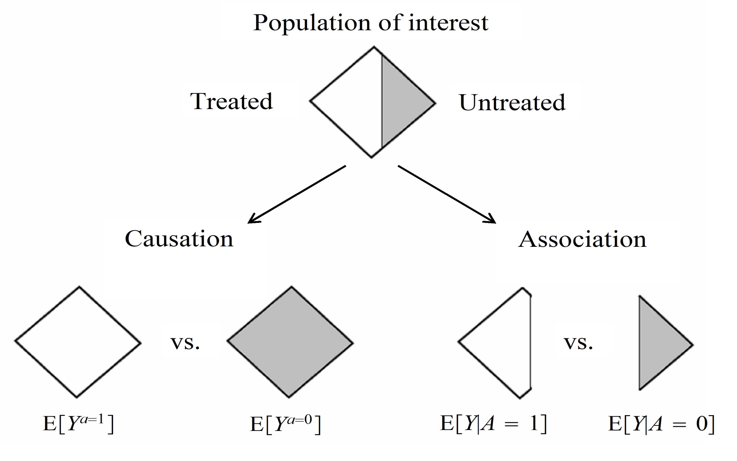
Associations vs. Causation
Hernán, M.A. and Robins, J.M. (2025) Causal Inference: What If. Boca Raton: Chapman & Hall/CRC. Available at: https://miguelhernan.org/whatifbook (Accessed: 18 July 2025).
Notes:
Plain slide with subhead and bullets

Slide 17
Selecting Appropriate Causal Methods
In the absence of a randomized trial, we can leverage information from large observational / “real-world” datasets to estimate similar quantities of interest by emulating randomization.
To emulate randomization, causal methods mostly rely on one of two approaches:
Quasi-Experimental methods: Methods that leverage natural experiments or quasi-random variation in the data (e.g., instrumental variables, difference-in-differences, regression discontinuity design, interrupted time series)
Adjustment Based Methods: Methods that aim to control for individual confounding factors of interest (e.g., propensity score methods, inverse probability weighting, parametric g-formula)
However, do note that:
The “causal” methods are referring to are attempts to estimate the causal effect, with certain assumptions underlying the methods we use.
Effect estimates will probably still be biased compared to randomised controlled trials, but with the right data, methods, and assumptions, we can try to get close to them.
Even imperfect emulations improve clarity and validity by making assumptions and limitations transparent.
Notes:
Consider points -> now that we have large observational datasets, we should leverage them in the absence of trials
Emphasise that this isn’t being done in all situations
Focus more on high value decisions or projects where you do want to do this

Slide 18
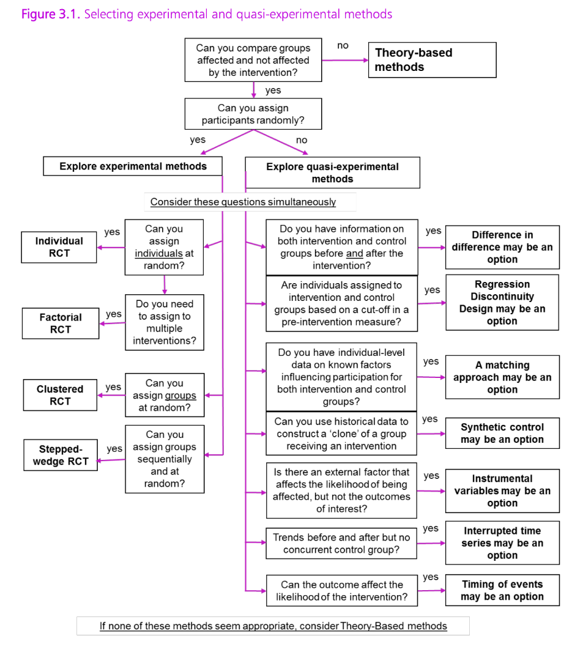
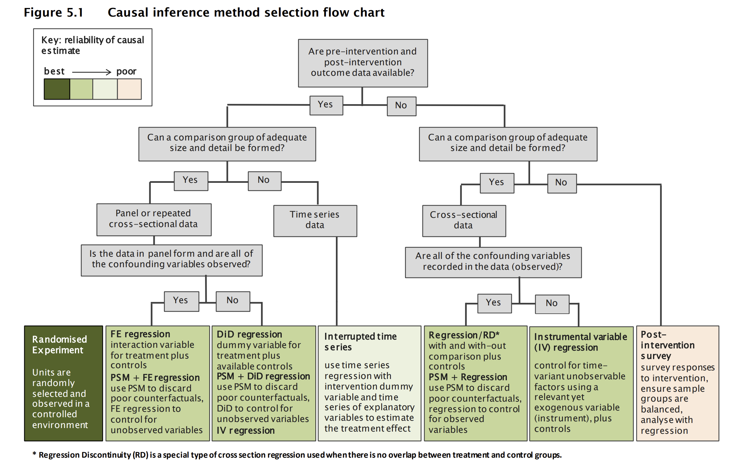
Current Guidance
HM Treasury (2020) Magenta Book: Central Government guidance on evaluation. United Kingdom: HM Treasury. Available at: https://assets.publishing.service.gov.uk/media/5e96cab9d3bf7f412b2264b1/HMT_Magenta_Book.pdf.
Schiff, A., Wright, L. and Denne, T. (2017) Ex-post evaluation of transport interventions using causal inference methods. NZ Transport Agency Waka Kotahi. Available at: https://nzta.govt.nz/resources/research/reports/630/ (Accessed: July 23, 2025).

Slide 19
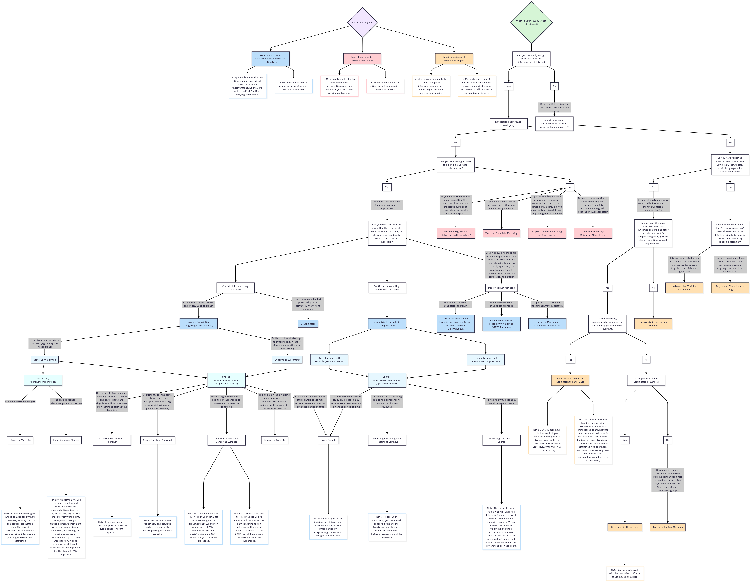
Causal Methods Taxonomy
Notes:
Plain slide with subhead and bullets

Slide 20
Quasi-Experimental Methods
Section 3

Slide 21
Overview of Quasi-Experimental Methods
Roots in econometrics and quantitative social sciences (e.g., Imbens, Angrist) Developed to estimate causal effects when randomized trials were not feasible, particularly in policy and labour market evaluations from the 1970s onwards.
Leverages natural or policy driven variation in the data Exploit quasi-random events such as policy changes, eligibility thresholds, or timing differences to mimic random assignment.
Applicable in data limited settings Gained popularity because they required fewer individual level covariates or detailed confounder data than regression adjustment approaches.
Shift in assumptions compared to RCTs and adjustment based methods Rather than aiming to adjusting for all confounding factors, these methods rely on external shocks or policy driven variation in the data that can approximate randomization.
Universal assumptions to consider All methods assume the Stable Unit Treatment Value Assumption (SUTVA): i.e., no spillover effects between treatment groups and a consistently defined intervention

Slide 22
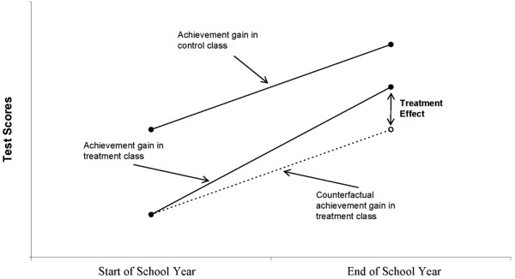
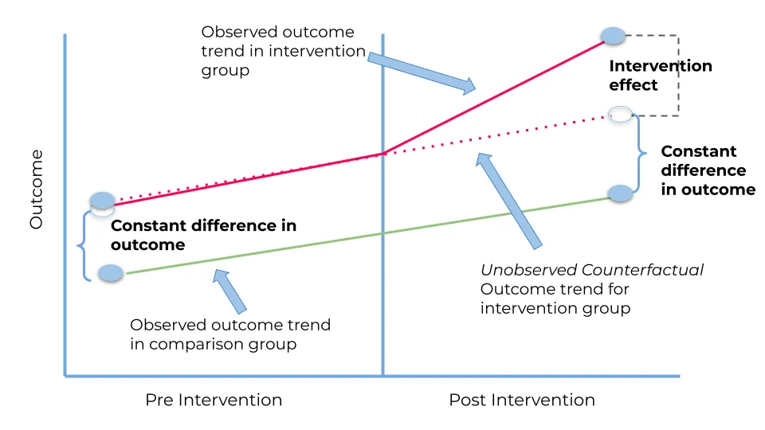
Difference-in-Differences
Overview
One of the simplest and most popular QE methods.
Compares changes in outcomes over time between a group exposed to an intervention (treatment) and a similar group not exposed (control).
Grounded in the idea that if both groups would have followed parallel trends in the absence of the intervention, any divergence afterwards can be attributed to the intervention.
Key Assumption(s)
In the absence of treatment, the treated group would have followed the same trend in outcomes as the control group (parallel trends assumption).
Relevant Situations
When you have before-and-after data for both intervention and comparison groups (panel or repeated cross-sectional data).
Commonly used to evaluate the rollout of new policy, service changes, or programme introductions that occur at a specific point in time.
Schwerdt, G. and Woessmann, L. (2020) “Chapter 1 - Empirical methods in the economics of education,” in S. Bradley and C. Green (eds.) The Economics of Education (Second Edition). Academic Press, pp. 3–20. Available at: https://doi.org/10.1016/B978-0-12-815391-8.00001-X.
Lovasi, G. (2016) Difference-in-Difference Estimation, Columbia University Mailman School of Public Health. Available at: https://www.publichealth.columbia.edu/research/population-health-methods/difference-difference-estimation (Accessed: October 14, 2025).

Slide 23
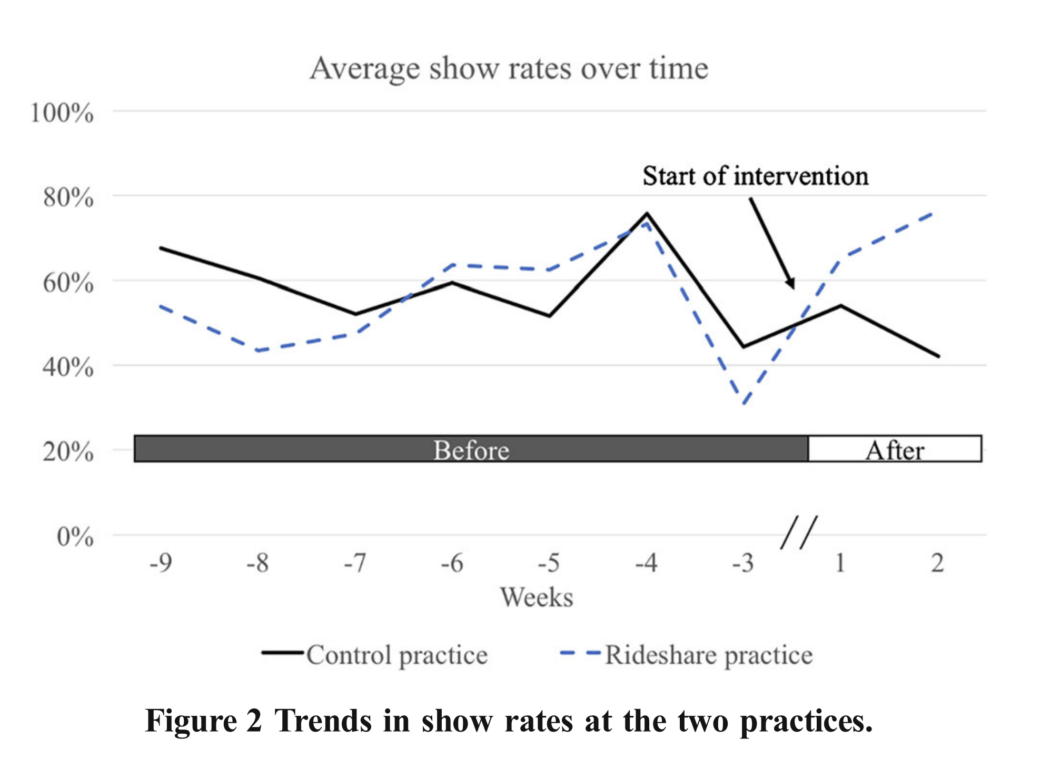
DiD Ex.: Rideshare for Medicaid Patients
Background
“Transportation to primary care is a well-documented barrier for patients with Medicaid... Rideshare services, which offer greater convenience and lower cost, have been proposed as an alternative.”
Design
“In one of two similar practices [in West Philadelphia], all eligible Medicaid patients were offered rideshare-based transportation (“rideshare practice”).”
Results
“The odds of showing up for an appointment before and after implementation of the intervention changed significantly by a factor of 2.57 (95% CI 1.10–6.00) more in the rideshare practice compared to the control practice.”
Note that these results assume parallel trends
Chaiyachati, K.H. et al. (2018) “Rideshare-Based Medical Transportation for Medicaid Patients and Primary Care Show Rates: A Difference-in-Difference Analysis of a Pilot Program,” Journal of General Internal Medicine, 33(6), pp. 863–868. Available at: https://doi.org/10.1007/s11606-018-4306-0.

Slide 24
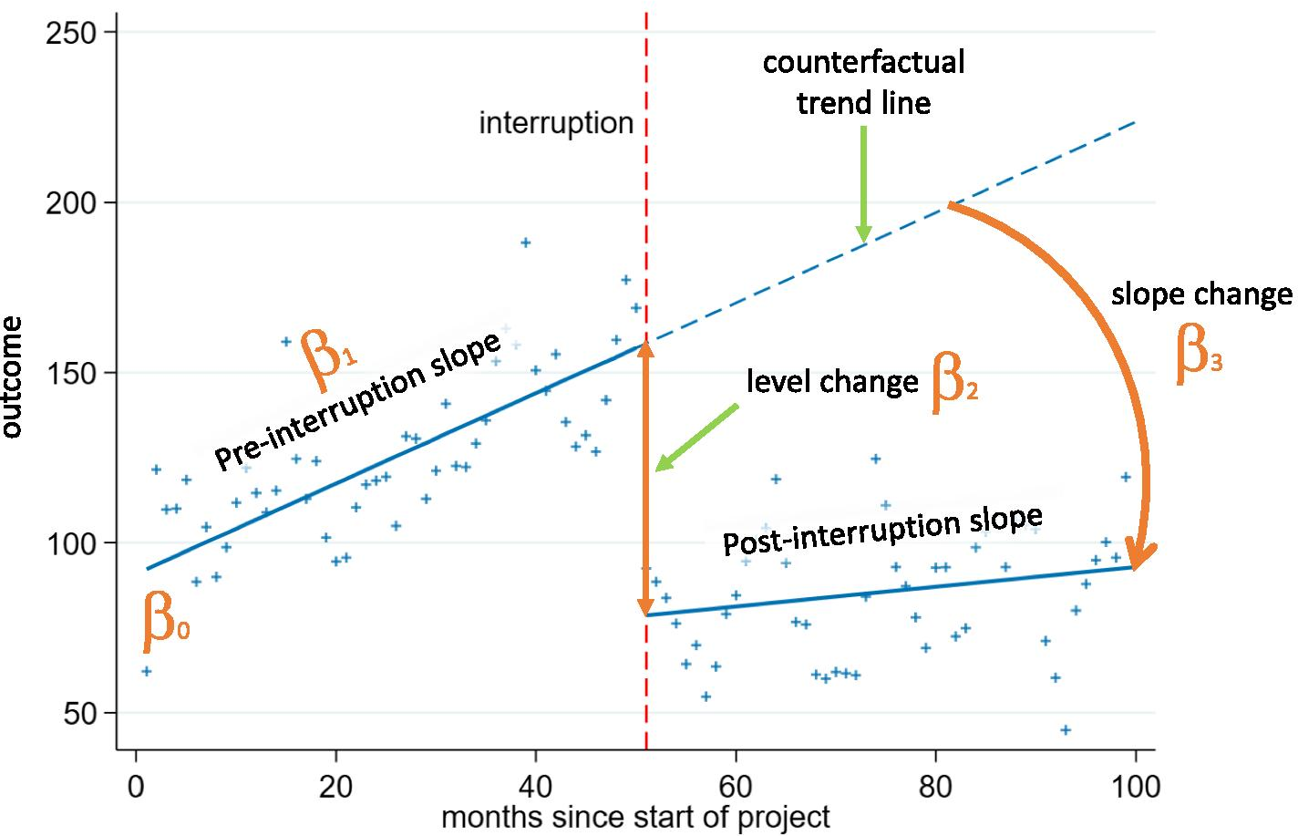
Interrupted Time Series
Overview
A widely used method to evaluate interventions introduced at a clearly defined point in time, and often in the absence of a comparator group.
Uses a continuous sequence of outcome data (e.g., monthly admissions, prescribing rates) to establish a pre-intervention trend, then assesses whether that trend changes after the intervention.
The pre-intervention trend provides the counterfactual: what would have happened had the intervention not occurred.
Seasonality and other external shocks (e.g., industrial action) can be controlled for.
Key Assumption(s)
In the absence of the intervention, the underlying trend would have continued unchanged.
No other time-varying confounders or concurrent events occurred at the same time which could explain the observed change.
Data are collected at regular intervals with enough time points before and after the intervention to detect trend shifts.
Relevant Situations
Evaluating system wide or national policies applied to all populations at once (e.g. smoking bans, vaccine introductions, clinical guidance changes), where no clear control group exists.
When routinely collected data (e.g. electronic health records) are available at regular intervals.
Turner, S.L. et al. (2021) “Comparison of six statistical methods for interrupted time series studies: empirical evaluation of 190 published series,” BMC Medical Research Methodology, 21(1), p. 134. Available at: https://doi.org/10.1186/s12874-021-01306-w.

Slide 25
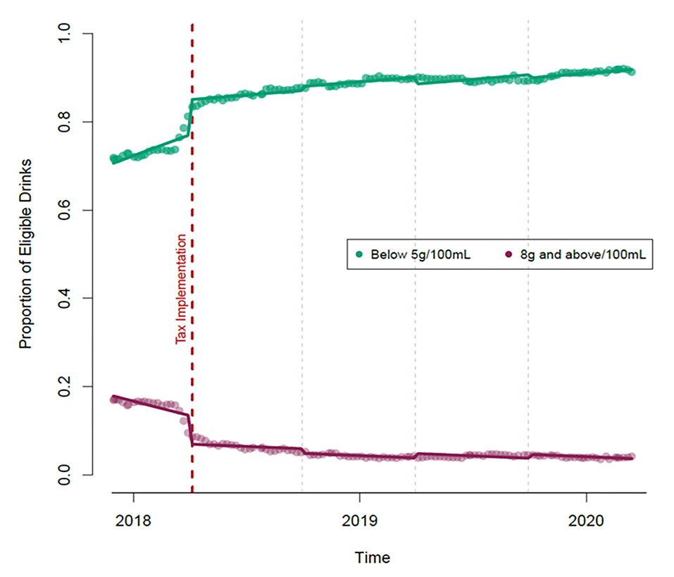
ITS Ex.: UK Soft Drink Industry Levy
Background
“In April 2018, the UK government implemented a levy on soft drinks importers and manufacturers… The stated aim was to encourage manufacturers to reduce sugar and portion sizes.”
Design
“Product data from 30 November 2017 to 14 March 2020 from one major UK retail supermarket were analysed (112,452 observations, 126 weekly time points). We used interrupted time series analysis, to assess the impact of the soft-drink industry levy (SDIL) on levy-eligible soft drinks”
Results
“At the point of implementation of the SDIL (April 2018) there was a step change in the proportion of eligible drinks with sugar content below the SDIL levy threshold (5g per 100ml) (+0.08, 95%CI: +0.04, +0.12), with a similar sized decrease in the proportion in the highest levy category (> = 8g sugar per 100ml) (-0.06, 95%CI: -0.10, -0.03).”
Luick, M. et al. (2024) “The impact of the UK soft drink industry levy on the soft drink marketplace, 2017–2020: An interrupted time series analysis with comparator series,” PLOS ONE, 19(6), p. e0301890. Available at: https://doi.org/10.1371/journal.pone.0301890.

Slide 26
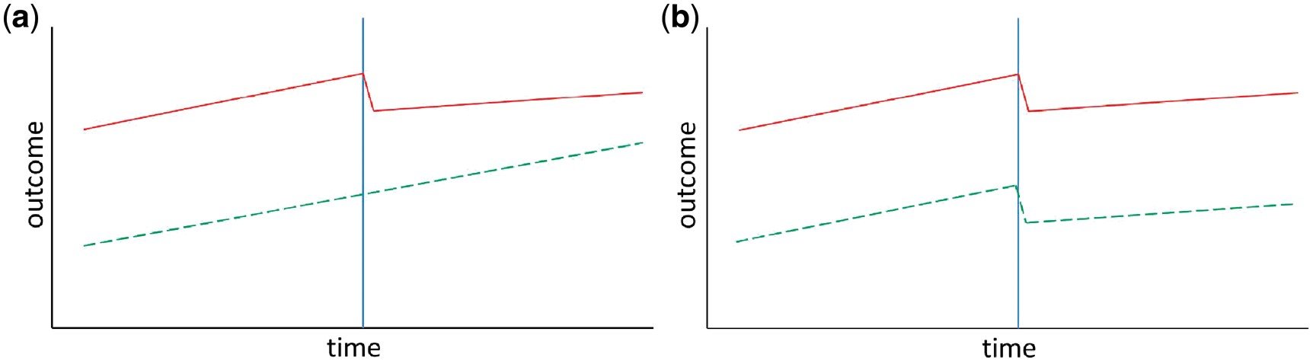
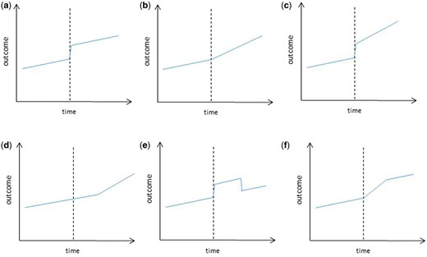
Controlled Interrupted Time Series
Overview
Extension of the standard Interrupted Time Series (ITS) design.
Combines before after comparisons within a population (as in ITS) with a control series not exposed to the intervention (as in DiD).
Strengthens causal inference by distinguishing intervention effects from concurrent interventions or other external shocks and time-varying confounders.
Note that DiD estimates a single post-intervention change between groups, while CITS models both the immediate change and the ongoing trend, showing how outcomes continue to evolve over time.
Key Assumption(s)
Same as standard ITS designs.
Additionally assumes parallel pre-intervention trends between series and that the control group shares similar characteristics to the treatment group.
The outcome measure should change only in the treatment group and not in the control group (fig a is ideal, fig b indicates that the change is due to another event or intervention)
Relevant Situations
Cross-region or cross-country comparisons of nationally implemented interventions (e.g., comparison of North Central and North East London).
Requires high quality time series data for a sustained period of time for two groups/locations, which may be challenging to obtain.
Turner, S.L. et al. (2021) “Comparison of six statistical methods for interrupted time series studies: empirical evaluation of 190 published series,” BMC Medical Research Methodology, 21(1), p. 134. Available at: https://doi.org/10.1186/s12874-021-01306-w.
Bernal, J.L., Cummins, S. and Gasparrini, A. (2017) ‘Interrupted time series regression for the evaluation of public health interventions: a tutorial’, International Journal of Epidemiology, 46(1), pp. 348–355. Available at: https://doi.org/10.1093/ije/dyw098.
Notes:
“Figure 1
Controlled interrupted time series. Solid line = intervention series, dashed line = control series. (a) Here there is an effect in the intervention series (step and slope decrease) but no effect in the control series, which increases confidence that the effect is due to the intervention. (b) Here there is a step and slope decrease in both the intervention and control series, suggesting the change is due to some other event or co-intervention that affected both groups.”

Slide 27
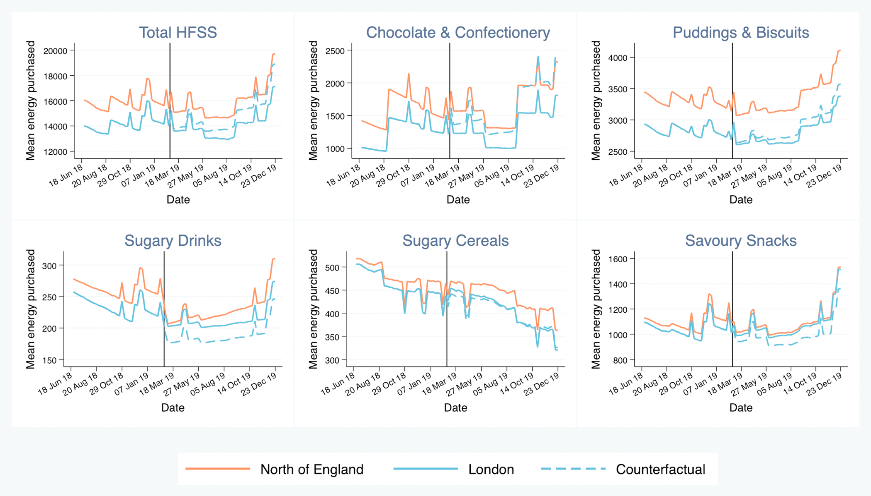
CITS Ex.: TFL HFSS Advertising Restrictions
Background
“Restricting the advertisement of products with high fat, salt, and sugar (HFSS) content has been recommended as a policy tool to improve diet and tackle obesity…”
“This study aimed to evaluate the impact of HFSS advertising restrictions, implemented across the London (UK) transport network in February 2019, on HFSS purchases.”
Design
“Using a controlled interrupted time series design, we estimated average weekly household purchases of energy and nutrients from HFSS products in the post-intervention period (44 weeks) compared to a counterfactual constructed from the control and pre-intervention (36 weeks) series.”
Results
“Energy purchased from HFSS products was 6.7% (1,001.0 kcal, 95% CI 456.0 to 1,546.0) lower among intervention households compared to the counterfactual.”
Yau, A. et al. (2022) “Changes in household food and drink purchases following restrictions on the advertisement of high fat, salt, and sugar products across the Transport for London network: A controlled interrupted time series analysis,” PLOS Medicine, 19(2), p. e1003915. Available at: https://doi.org/10.1371/journal.pmed.1003915.

Slide 28
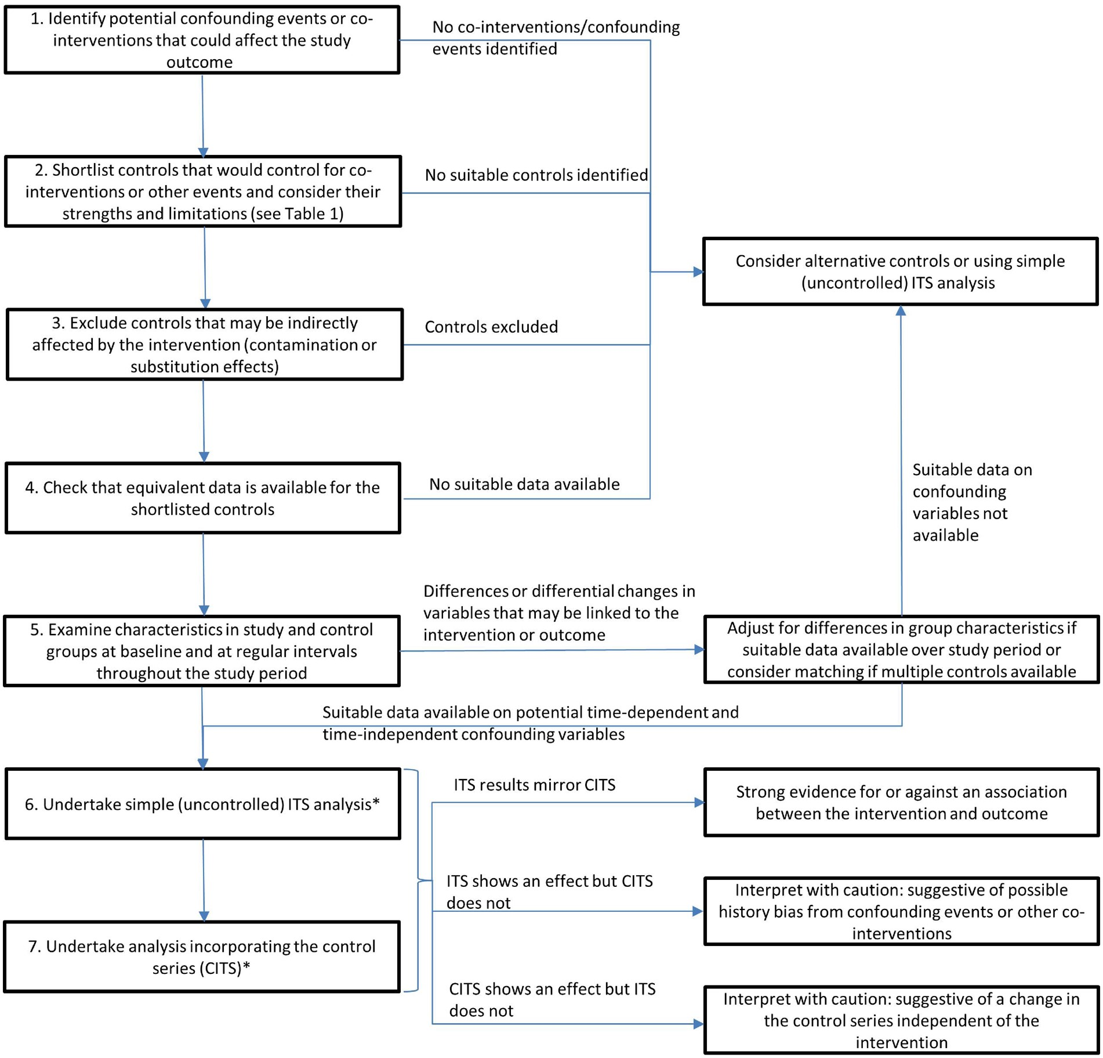
Performing a Controlled Interrupted Time Series
Lopez Bernal, J., Cummins, S. and Gasparrini, A. (2018) “The use of controls in interrupted time series studies of public health interventions,” International Journal of Epidemiology, 47(6), pp. 2082–2093. Available at: https://doi.org/10.1093/ije/dyy135.

Slide 29
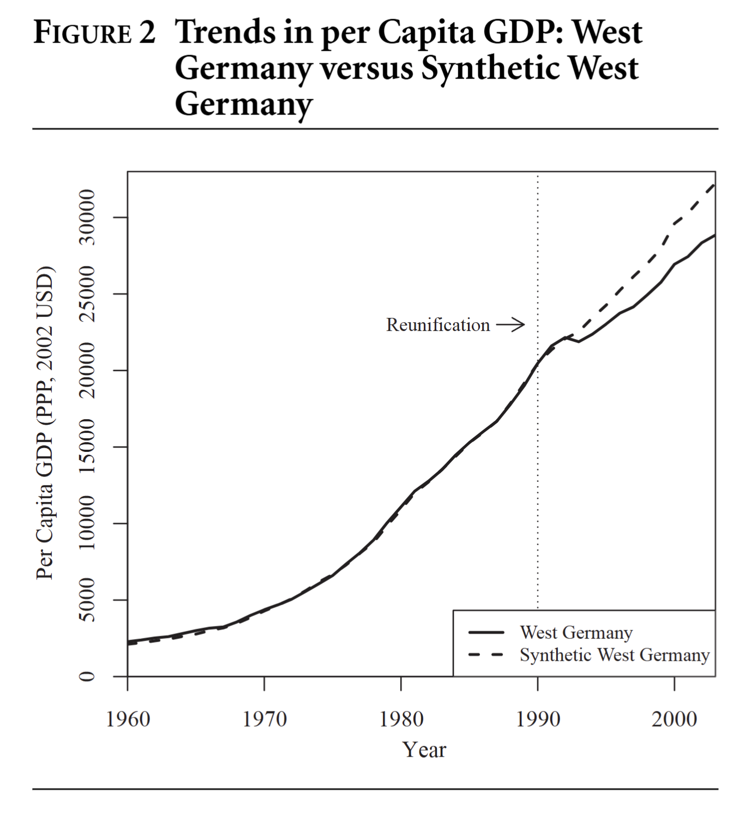
Synthetic Controls
Overview
Constructs a synthetic version of the treated unit, i.e. a weighted combination of multiple untreated “donor” units that best reproduces its pre-intervention characteristics and trends.
Provides a data-driven counterfactual when no single comparison group offers a credible match.
The treatment effect is estimated as the difference between the observed outcome for the treated unit and its synthetic counterpart after the intervention.
Key Assumption(s)
The weighted combination of control units closely reproduces the pre-intervention trajectory of the treated unit (good pre-treatment fit).
In the absence of the intervention, the treated unit would have followed the same trend as the synthetic control.
No spillover or interference between treated and control units.
Relevant Situations
When ITS and CITS assumptions are too restrictive or when no suitable single control group is available.
Particularly suited for aggregate level interventions where randomisation is infeasible, but similar data is collected for other regions and/or countries with similar characteristics.
Abadie, A., Diamond, A. and Hainmueller, J. (2015) “Comparative Politics and the Synthetic Control Method,” American Journal of Political Science, 59(2), pp. 495–510. Available at: https://doi.org/10.1111/ajps.12116.

Slide 30
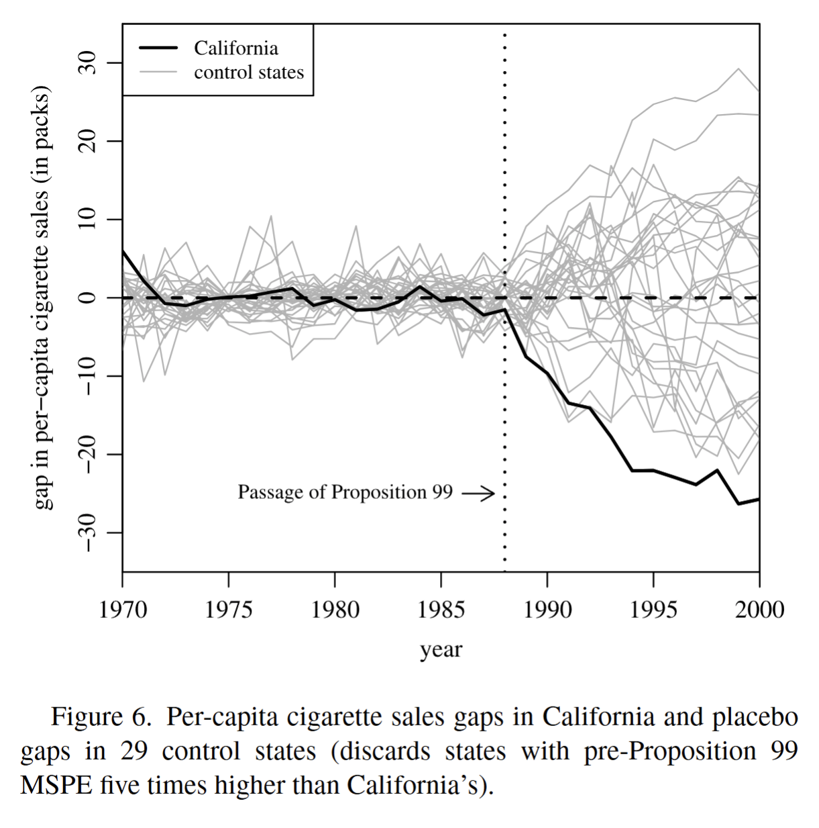
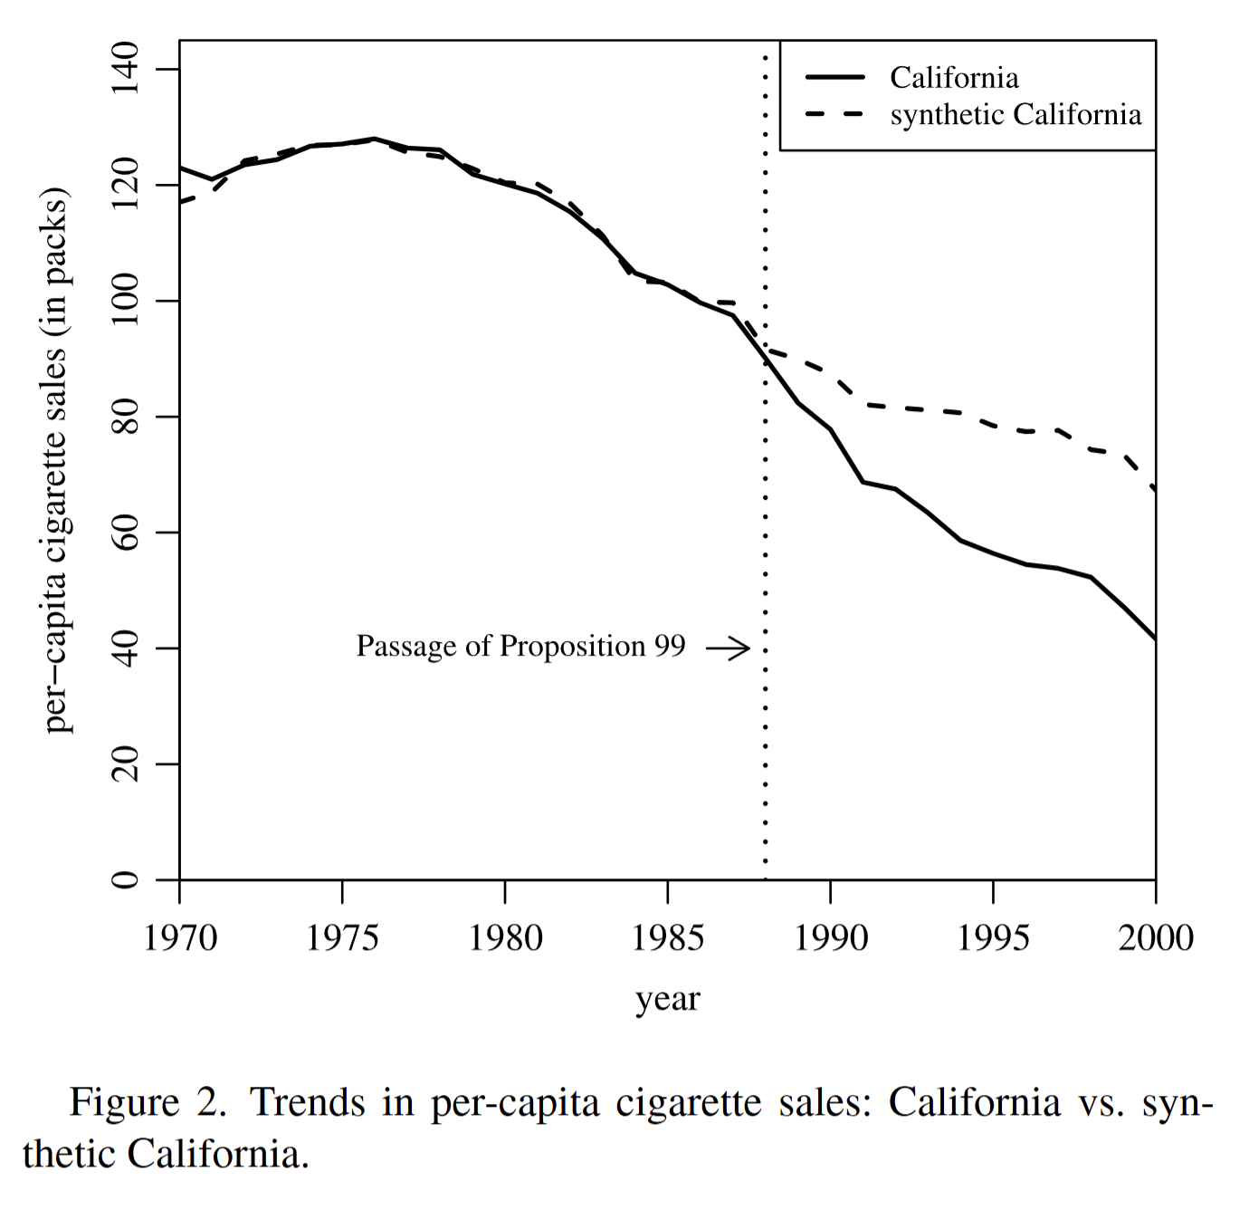
SC Ex.: California’s Tobacco Control Program
Background
“Anti-tobacco legislation has a long history in the United States… Leading this wave, in 1988, was a voter initiative in California known as Proposition 99,the ﬁrst modern-time large-scale tobacco control program in the United States.”
“Proposition 99 increased California’s cigarette excise tax by 25 cents per pack…”
Design
“This article investigates the application of synthetic control methods to comparative case studies. We discuss the advantages of these methods and apply them to study the effects of Proposition 99.”
Results
“We demonstrate that, following Proposition 99, tobacco consumption fell markedly in California relative to a comparable synthetic control region.”
“Our results suggest that for the entire 1989–2000 period cigarette consumption was reduced by an average of almost 20 packs per capita, a decline of approximately 25%.”
Abadie, A., Diamond, A. and Hainmueller, J. (2010) “Synthetic Control Methods for Comparative Case Studies: Estimating the Effect of California’s Tobacco Control Program,” Journal of the American Statistical Association, 105(490), pp. 493–505. Available at: https://doi.org/10.1198/jasa.2009.ap08746.

Slide 31
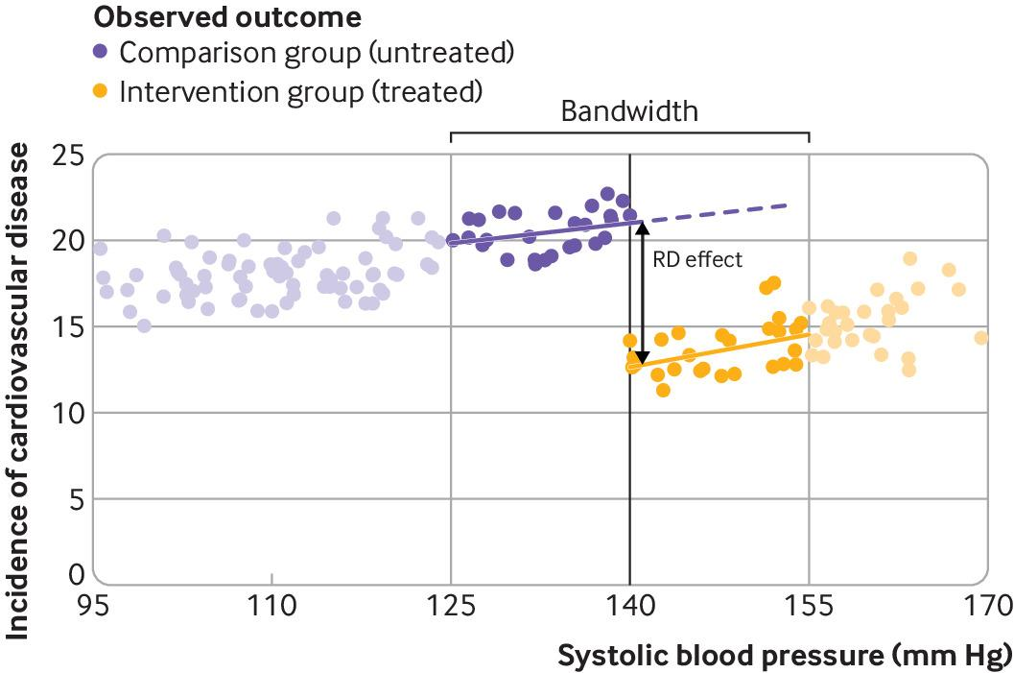
Regression Discontinuity Design
Overview
A rule-based evaluation design that uses a clear threshold or eligibility cut-off to determine who receives an intervention and who does not.
Compares outcomes for people just above and just below that threshold (based on a pre-specified bandwidth), assuming they are otherwise similar (as if randomized).
Like an Interrupted Time Series, but instead of looking for a change over time, RDD looks for a change across a threshold in a continuous measure / running variable (e.g., risk score > 10/20, age > 60, blood pressure > 140mm Hg)
The design can be “sharp” (strict rule) or “fuzzy” (rule partly determines eligibility).
Key Assumption(s)
Individuals near the threshold are comparable and differ only in whether they receive the intervention.
There is no manipulation around the threshold (e.g., people can’t influence their score to qualify).
The relationship between the measure and the outcome is otherwise smooth, so any sharp jump at the threshold can be attributed to the intervention.
Relevant Situations
Particularly useful for evaluating clinical guidelines, benefit thresholds, or funding criteria, when the treatment is determined by a fixed rule or scoring system.
Calonico, S. et al. (2024) “Regression discontinuity design studies: a guide for health researchers,” BMJ, 384, p. e072254. Available at: https://doi.org/10.1136/bmj-2022-072254.

Slide 32
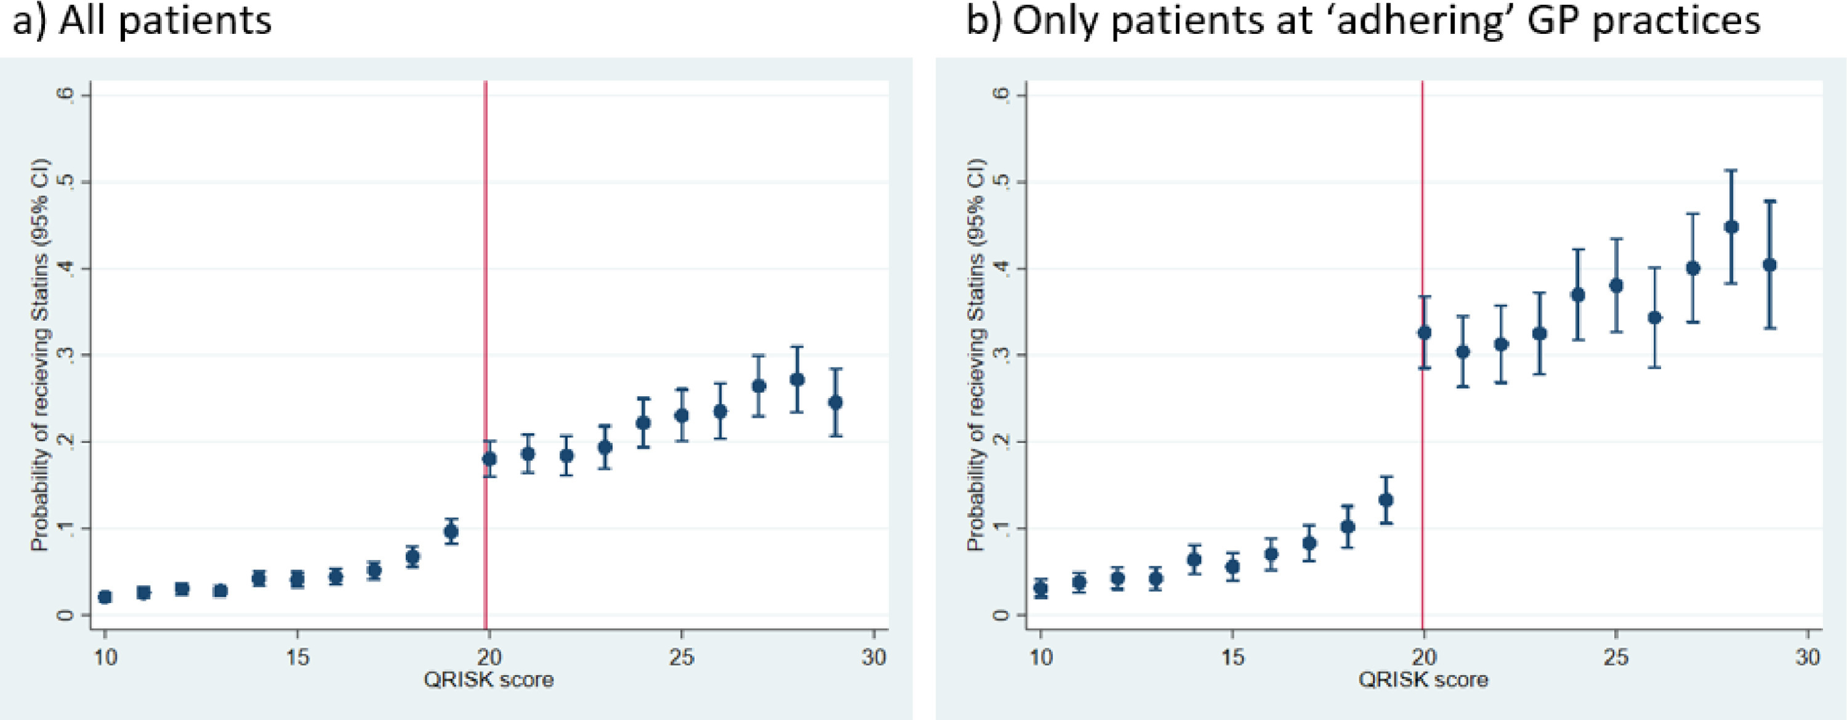
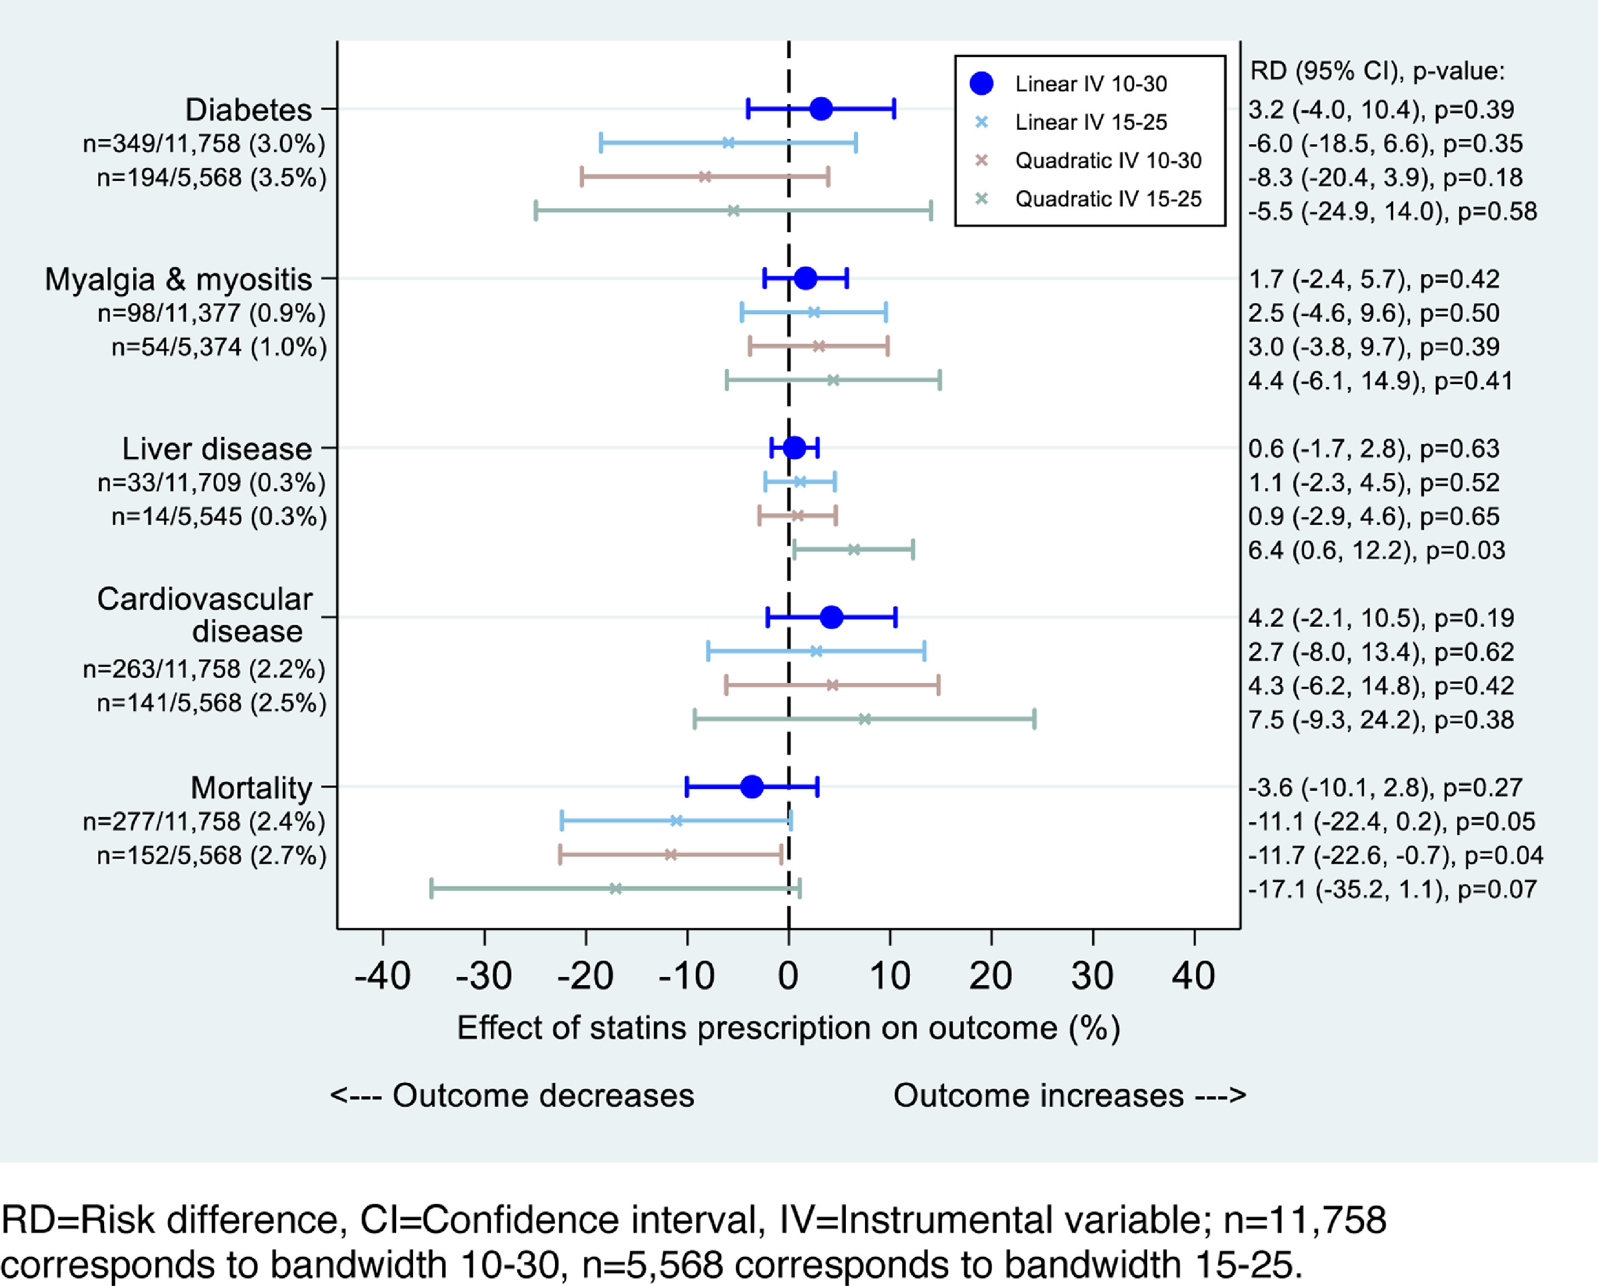
SC Ex.: Effects of Statins on Cholesterol & Adverse Outcomes
Background
“The QRISK/QRISK2 cardiovascular risk score uses factors including cholesterol, sex, and age to predict CVD event risk in the next 10 years.”
“NICE recommended GPs prescribe statins to patients aged 18 and above with QRISK score 20 or above.”
“This score can be used as assignment variable to study statins using RDA.”
Design
“The study aims to explore the use of regression discontinuity analysis (RDA) to examine effects of prescription of statins on total cholesterol and adverse outcomes (type 2 diabetes, rhabdomyolysis and myopathy, myalgia and myositis, liver disease, CVD, and mortality).”
Results
“RDA confirmed statin prescription reduced total cholesterol (Mean difference (MD) -1.33 mmol/L, 95% Confidence Interval (CI) -1.93 to -0.73).”
“RDA provided little evidence for adverse effects on diabetes, myalgia and myositis, liver disease, CVD, or mortality.”
Scott, L. et al. (2022) “Regression discontinuity analysis for pharmacovigilance: statin example reflected trial findings showing little evidence of harm,” Journal of Clinical Epidemiology, 141, pp. 121–131. Available at: https://doi.org/10.1016/j.jclinepi.2021.10.003.

Slide 33
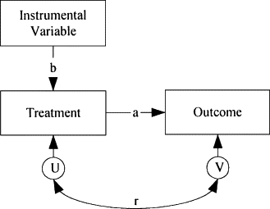
Instrumental Variables
Overview
Relies on finding a separate variable, referred to as the instrument, which influences whether someone receives the intervention but does not directly affect the outcome, except through that intervention.
Provides a way to mimic randomisation when treatment assignment isn’t random, by using an instrument that nudges units towards treatment, or through a natural experiment.
Key Assumption(s)
Relevance: The instrument meaningfully influences/is associated with the treatment.
Exogeneity/Independence: The instrument is not related to unmeasured confounders of the treatment outcome relationship.
Exclusion Restriction: The instrument affects the outcome only through its effect on treatment.
Monotonicity: No "defiers" who do the opposite of what the instrument encourages.
Relevant Situations
When there are policy rules or natural variations in the data that influence the exposure, and can be used as an instrument, such as:
Lottery assignment for programme participation
Genetic variants influencing a risk factor (Mendelian randomisation)
Clinician prescribing preference as a proxy for treatment likelihood
Distance to nearest hospital affecting access to services
Mehta, P.D. (2001) “Instrumental Variable Method,” in International Encyclopedia of the Social & Behavioral Sciences. Available at: https://www.sciencedirect.com/topics/economics-econometrics-and-finance/instrumental-variables (Accessed: October 15, 2025).

Slide 34
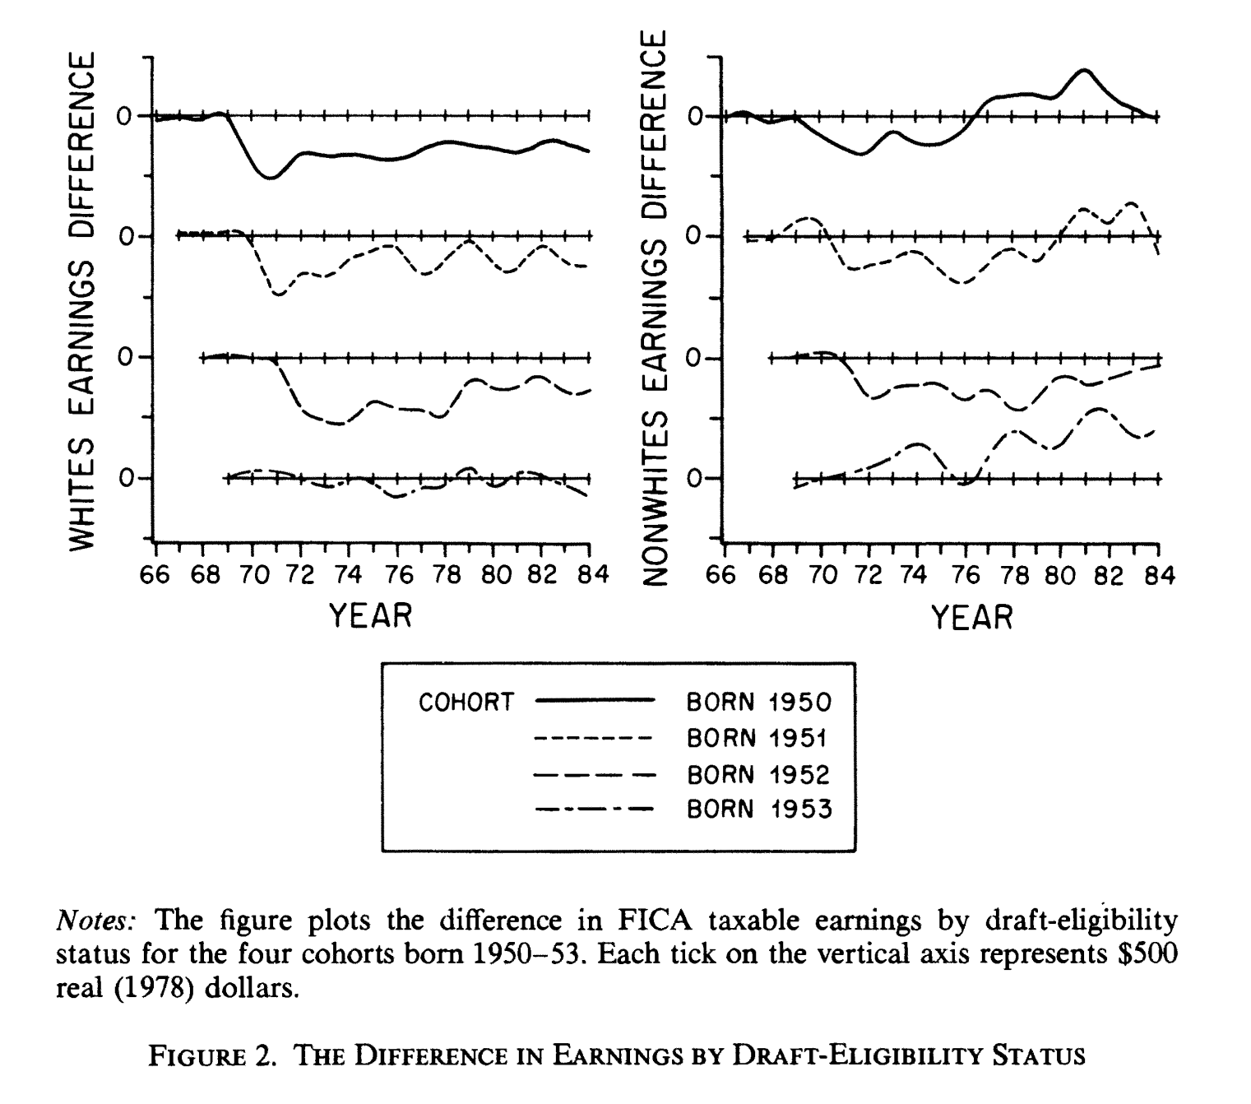
IV Ex.: Lifetime Earnings and the Vietnam Era Draft Lottery
Background
“The goal of this paper is to measure the long-term labor market consequences of military services during the Vietnam era.”
“Previous research comparing civilian earnings by veteran status may be biased by the fact that certain types of men are more likely to serve in the armed forces than others.” (e.g., men with fewer civilian opportunities are more likely to enlist)
Design
Social Security administrative records were linked to draft lottery numbers (1-365) from the Vietnam War period to create a natural experiment (a lower no. meant higher priority for induction).
“If draft eligibility is correlated with veteran status but uncorrelated with other variables related to earnings, then earnings differences by draft-eligibility status can be attributed to military service.”
Note: Lotteries were held from 1970-1973 for men born 1944-1953, though only those drawn in 1970-1972 resulted in actual inductions.
Results
“Results indicate that white veterans earn approximately 15 percent less than nonveterans as much as ten years after their discharge from the military, equivalent to a loss of two years of civilian labor market experience.”
Angrist, J.D. (1990) “Lifetime Earnings and the Vietnam Era Draft Lottery: Evidence from Social Security Administrative Records,” The American Economic Review, 80(3), pp. 313–336.
Notes:
Horizonal lines anchored at 0 serve as the reference group (those who were not drafted as part of the lottery), with the curves being the comparator group (those who were drafted).
You can see in the figure that those born in 1950-52 and were drafted saw their earnings slump and not recover after being drafted, compared to those that were not drafted. Those born in 1953 never drafted, hence showing not much of a difference between both groups.

Slide 35
Adjustment Based Methods
Section 4

Slide 36
Overview of Adjustment Based Methods
Roots in applied statistics and epidemiology These approaches extend traditional outcome regression models to better estimate causal effects from observational data.
Leverages adjustment of confounding factors of interest Aims to adjust for measured confounding factors to make treatment groups more comparable, mimicking what randomisation would have achieved.
Applicable in settings where data on a wide range of variables is available Is particularly popular in fields where rich data is available on a wide range of variables (demographic, clinical, behavioural) overtime (e.g., with NHS and ONS data)
Particularly relevant in head-to-head comparisons of treatments overtime G-Methods are uniquely able to adjust for time varying confounding to estimate the causal effect of fully adhering to treatment overtime.
Allows for more robust causal inference when combined with the Target Trial Emulation Framework

Slide 37
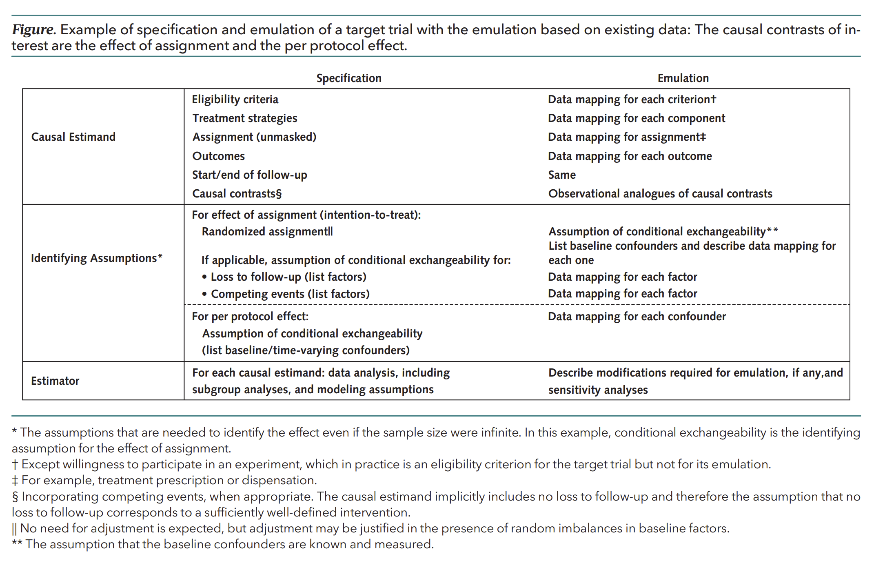
Aligning Observational Studies with the Gold Standard (RCTs)
Target Trial Emulation is a framework first established by Hernan and Robins in 2016 for comparative effectiveness research.
To overcome many common biases in conventional observational research, the framework makes the ideal randomized target trial explicit before any analysis is attempted.
The framework helps ensure that:
Eligibility criteria are clearly specified
The causal estimand of interest is clearly articulated
The analytical approach is outlined
All identifying assumptions and limitations are made explicit
Specifying a target trial also encourages engagement with stakeholders and incorporating expert opinion into the study design.
Hernán, M.A. et al. (2025) ‘The Target Trial Framework for Causal Inference From Observational Data: Why and When Is It Helpful?’, Annals of Internal Medicine, 178(3), pp. 402–407. Available at: https://doi.org/10.7326/ANNALS-24-01871.
Notes:
Descriptive titles – change them to be more approachable
Focus on articulating our problems properly, describing our analytical approach, making this work reproducible, on top of assumptions
Biases include: confounding bias, immortal time bias, lead time bias, depletion of susceptibles/prevalent user selection bias

Slide 38

How NICE’s RWE Framework Embeds Target Trial Principles
NICE Real-World Evidence Framework
“Non-randomised studies should be designed to mimic the randomised trial that would ideally have been performed unconstrained by ethical or feasibility challenges”
“Studies should aim to emulate the target trial as closely as possible and, if this is not possible, trade-offs should be clearly described.”
“The target trial can be defined across 7 dimensions: eligibility criteria, treatment strategies, assignment procedure, follow-up period, outcomes, causal effect of interest and analysis plan.”
Notes:
Elaborate that this started in academia, now in NICE, now we’re looking at ways to integrate it into the NHS (we’re considering whether its possible to adopt it in the NHS/feasibility and have a handbook for reference)s

Slide 39

When Observational Studies & Trials Tell Different Stories
Comparing postmenopausal hormone therapy (oestrogen with progestin) vs no hormone use:
Observational Study – Nurses’ Health Study (1996)
HR = 0.39 (95% CI: 0.18 – 0.78) over 27,161 person-years of follow-up
Grodstein, F. et al. (1996) ‘Postmenopausal Estrogen and Progestin Use and the Risk of Cardiovascular Disease’, New England Journal of Medicine, 335(7), pp. 453–461. Available at: https://doi.org/10.1056/NEJM199608153350701.
Randomized Controlled Trial (2003)
HR = 1.81 (95% CI: 1.09 – 3.01) at 1 year of follow-up
HR = 1.24 (95% CI: 1.00 – 1.54) for an overall average 5.6 years of follow-up
Manson, J.E. et al. (2003) ‘Estrogen plus Progestin and the Risk of Coronary Heart Disease’, New England Journal of Medicine, 349(6), pp. 523–534. Available at: https://doi.org/10.1056/NEJMoa030808.
Trial Emulation Study – Nurses’ Health Study with TTE (2008)
HR = 1.42 (95% CI: 0.92–2.20) at 2 years of follow-up
Hernán, M.A. et al. (2008) ‘Observational Studies Analyzed Like Randomized Experiments: An Application to Postmenopausal Hormone Therapy and Coronary Heart Disease’, Epidemiology, 19(6), p. 766. Available at: https://doi.org/10.1097/EDE.0b013e3181875e61.

Slide 40
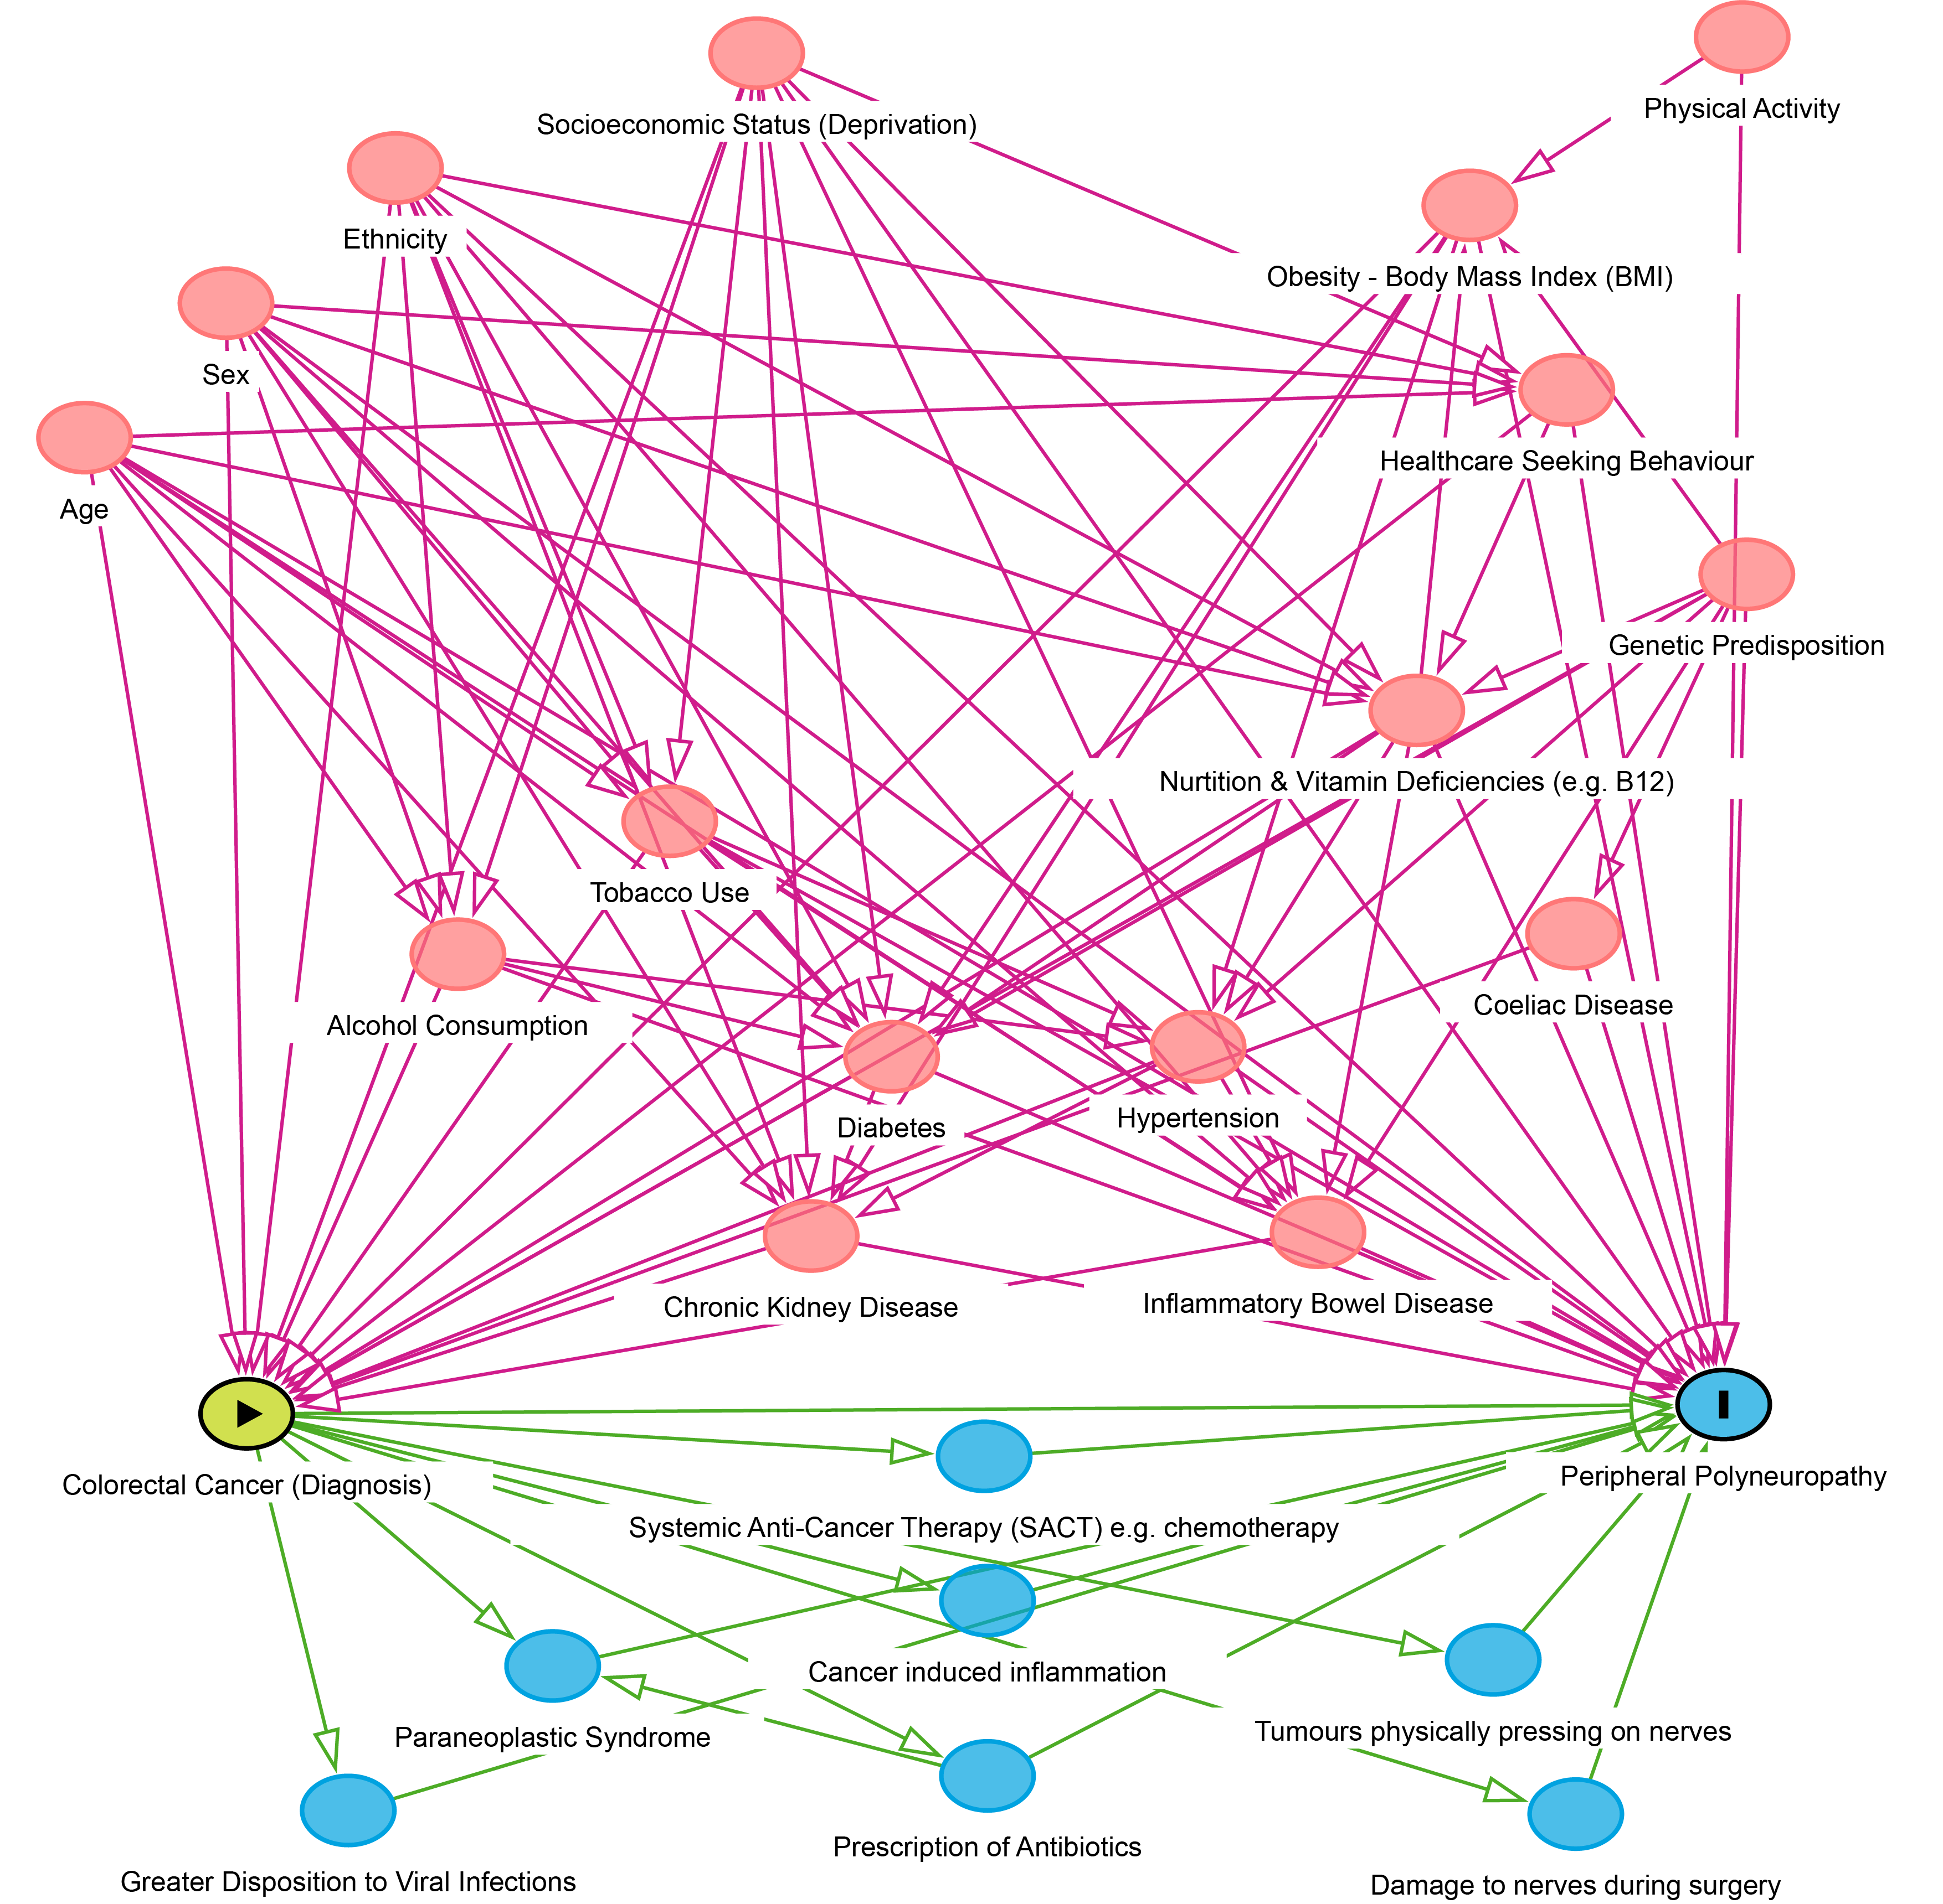
Directed Acyclic Graphs
Overview
Before applying adjustment-based methods, it is recommended to map out your assumed causal structure using a Directed Acyclic Graph (DAG).
A DAG visually represents how your treatment, outcome, and other variables are causally related, with nodes as variables and one-way arrows (edges) showing assumed causal direction.
Purpose
DAGs help identify which variables should be adjusted for to control confounding, and which variables should not be adjusted for to avoid introducing bias.
Adjusting for the wrong variable (e.g. a collider or a mediator) can create selection bias or distort the estimated effect.
They make your causal assumptions explicit, transparent, and testable.
Enables a discussion with clinical experts, and allows for the incorporation of clinical opinion into study design.
DAGs are also relevant for some quasi-experimental methods, though their application differs slightly from adjustment based methods.
DAGs can be easily created using online tools such as dagitty (https://www.dagitty.net/)

Slide 41
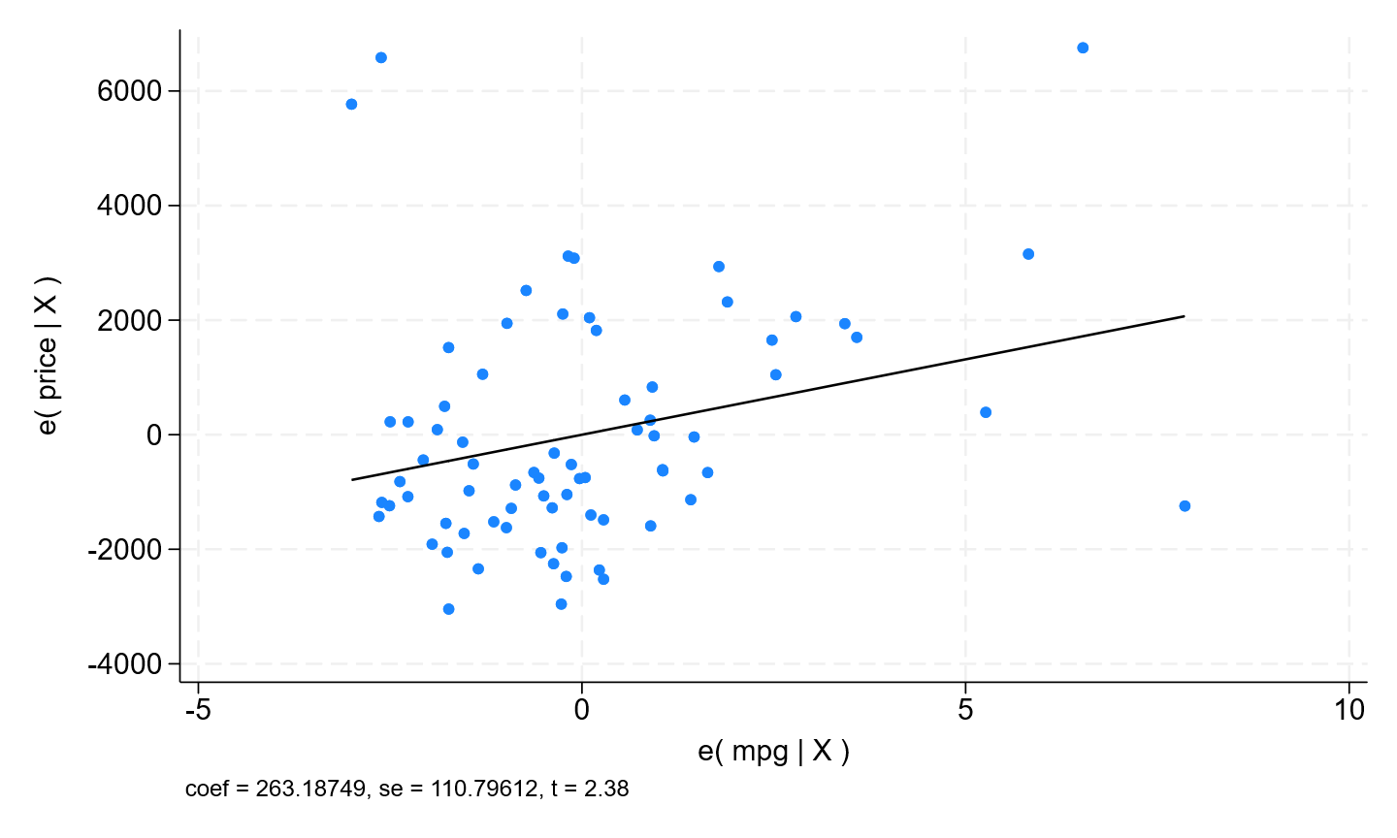
Shortcomings of Standard Outcome Regression Modelling
Even if a model is correctly specified, including:
Choosing the appropriate regression model for the question being asked (e.g., linear, logistic, log-binomial, Poisson, Cox).
Checks for normality and/or transformations applied to variables to adhere to model assumptions.
Selection of a relevant and comprehensive set of key variables to adjust confounding.
Important limitations remain:
Time-varying characteristics cannot be fully adjusted for.
Participants’ lifestyle, medication use, or health status may change over time.
Those who remain under follow-up (e.g., survivors) may differ systematically from those lost or deceased.
No straightforward way to assess covariate balance between treatment groups, as it is difficult to visualise whether comparability has been achieved.
Limited flexibility when outcomes are rare, as the number of covariates that can be included is constrained by the number of outcome events.
The following methods aim to address these issues.
Stata (no date) Linear regression and influence, Stata. Available at: https://www.stata.com/features/overview/linear-regression-and-influence/ (Accessed: 15 October 2025).

Slide 42
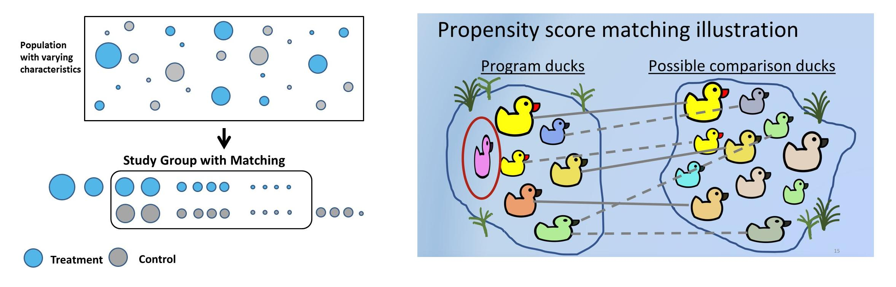
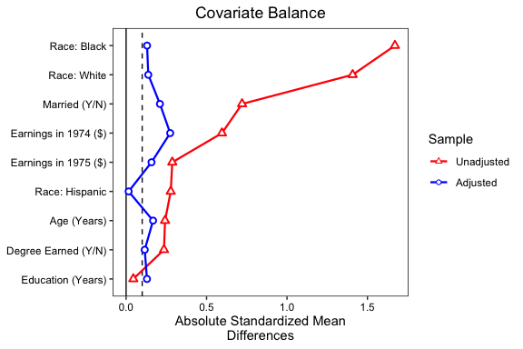
Propensity Score Matching
Overview
A method to emulate randomisation by pairing each treated participant with one or more untreated participants who had a similar probability (propensity) of receiving treatment, based on baseline characteristics.
A non-parametric approach, meaning it does not rely on assumptions about the functional form between covariates and outcomes (no need for variable transformations as in regression).
Particularly useful when there are many confounders or when the outcome is rare, since matching can achieve full covariate adjustment without overfitting.
Covariate balance between treatment groups can be directly checked and visualised (e.g. using standardized mean differences or Love plots).
Key Assumption(s)
Exchangeability (No unmeasured confounding): All relevant confounding variables are measured and correctly included so that treatment groups are comparable.
Relevant Situations
When analysing large administrative or registry datasets (e.g. NHS, ONS) with many potential comparators.
When the number of potential confounders is large and/or the outcome of interest is rare.
When you want to assess or visualise comparability between exposure groups before analysing outcomes.
Note: PS Matching is unable to adjust for time-varying confounding
Image: https://stats.stackexchange.com/questions/559516/is-propensity-score-matching-a-must-for-scientific-studies
Image: https://cran.r-project.org/web/packages/cobalt/vignettes/love.plot.html
Benedetto, U. et al. (2018) ‘Statistical primer: propensity score matching and its alternatives†’, European Journal of Cardio-Thoracic Surgery, 53(6), pp. 1112–1117. Available at: https://doi.org/10.1093/ejcts/ezy167.

Slide 43
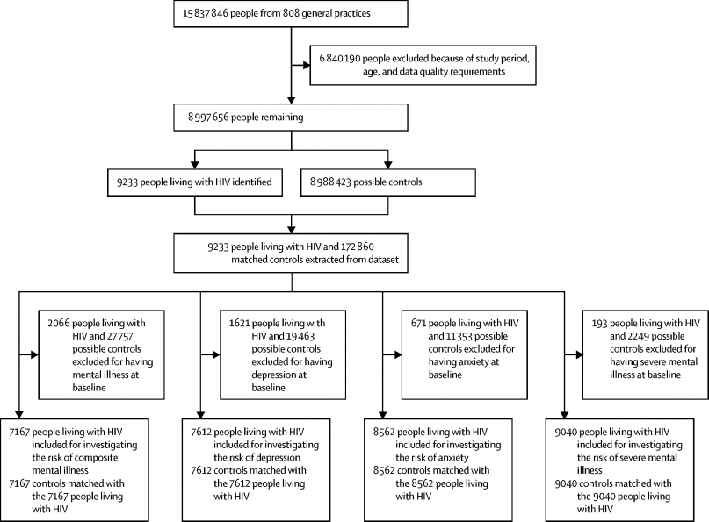
PSM Ex.: Risk of mental illness in people living with HIV in the UK
Background
“Prevalence of mental illness is higher in people living with HIV than in the general population, but the incidence of composite mental illness and its components is unclear.”
“We aimed to identify the risk of incident mental illness along with individual conditions of depression, anxiety, and severe mental illness in people living with HIV in the UK.”
Design
“Data for this population-based cohort were extracted from the IQVIA Medical Research Database, a nationally representative UK-based database of primary care electronic health records.”
“We included adults (aged ≥18 years) living with HIV, matched with adults without HIV using propensity score matching (1:1 ratio).”
“The primary outcome was composite mental illness comprising a diagnosis of depression, anxiety, or severe mental illness. Secondary outcomes were individual mental health conditions.”
“Cox proportional hazard regression models were used to compare the risk of each outcome between people with and without HIV. Each model excluded those with the outcome at baseline.”
Results
“Of 7167 people living with HIV without mental illness at baseline, 586 developed a mental illness (incidence rate 19·6 per 1000 person-years) compared with 418 of 7167 people without HIV (incidence rate 12·1 per 1000 person-years), resulting in an adjusted hazard ratio (HR) of 1·63 (95% CI 1·44–1·85).”
Gooden, T.E. et al. (2022) ‘The risk of mental illness in people living with HIV in the UK: a propensity score-matched cohort study’, The Lancet HIV, 9(3), pp. e172–e181. Available at: https://doi.org/10.1016/S2352-3018(21)00319-2.

Slide 44
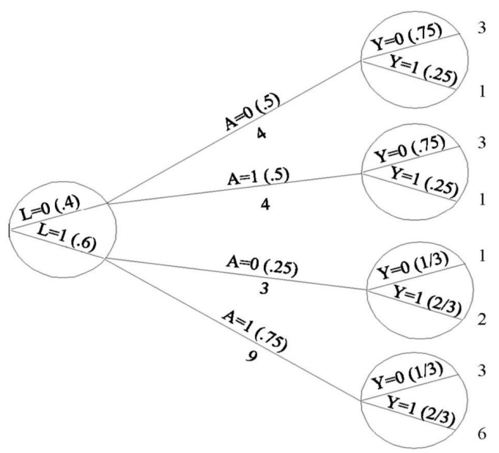
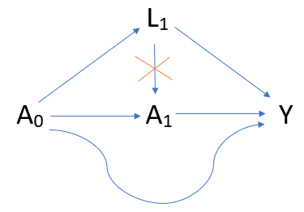
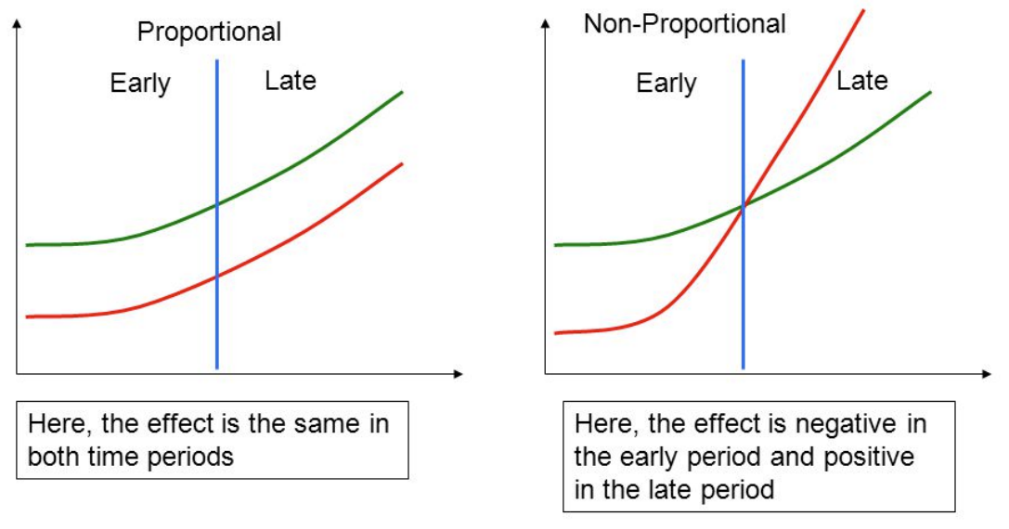
Inverse Probability Weighting
Overview
An extension of propensity score weighting designed to handle time-varying confounding, when covariates both change over time and are affected by prior treatment.
Each individual is weighted by the inverse of the probability of receiving the treatment they actually received, given their observed history up to that point.
This creates a weighted “pseudo” population in which treatment assignment is balanced with respect to measured confounders, mimicking a randomized trial at each time step.
When combined with pooled logistic regression, IPW allows estimation of time-to-event effects without assuming proportional hazards, which can be visualized using cumulative risk curves.
Key Assumption(s)
Consistency: Well defined interventions that are consistent for all participants (e.g., same dosage and method of delivery in a drug trial).
Exchangeability (No unmeasured confounding): All relevant confounding variables are measured and correctly included so that treatment groups are comparable.
Positivity: All participants have a positive probability of receiving treatment (e.g., if we’re studying the effect of physical activity, and some patients were disabled and bedbound, they would not be able to hypothetically carry out the intervention).
Relevant Situations
Evaluating long-term patient level treatment strategies, and the effect of full adherence is of interest (e.g. long-term diabetes medication use, not smoking for a decade).
When exposures and confounders evolve during follow-up (e.g. changes in blood pressure, smoking, weight, or comorbidities).
When survival models fail to meet proportional hazards assumptions and/or effects are expected to vary over time.
Best used when we are more confident about modelling the treatment process than the outcome.
Hernán, M.A. and Robins, J.M. (2025) Causal Inference: What If. Boca Raton: Chapman & Hall/CRC. Available at: https://miguelhernan.org/whatifbook (Accessed: 18 July 2025).

Slide 45
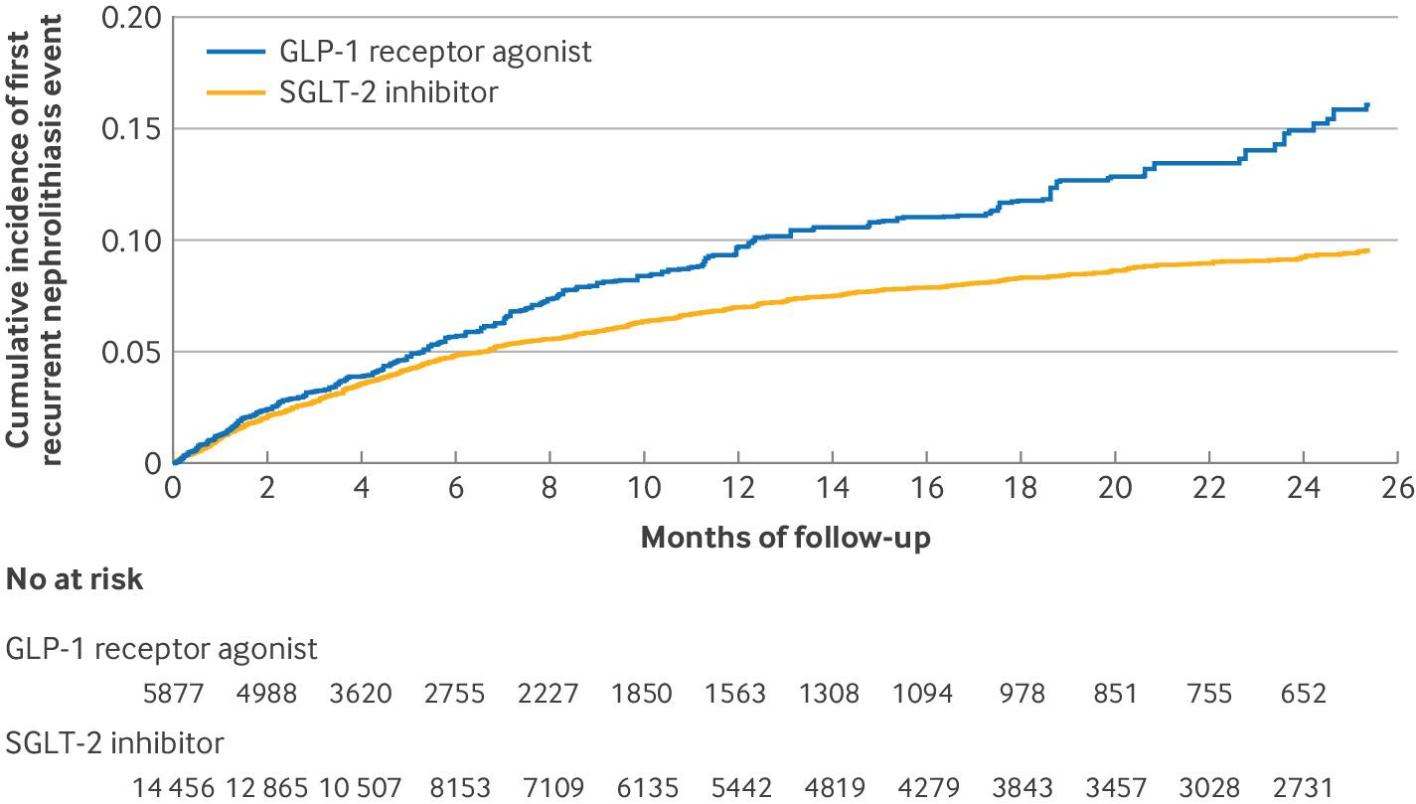
IPW Ex.: Comparative Effectiveness of SGLT-2 Inhibitors, GLP-1 Receptor Antagonists, and DPP-4 Inhibitors for Recurrent Nephrolithiasis (Kidney Stones)
Background
“SGLT-2 inhibitors increase urinary flow with osmotic diuresis and thus may lower the risk of nephrolithiasis; however, data on recurrence of nephrolithiasis are limited and not available among those with concurrent gout.”
Design
“We… emulate[d] two arm randomized clinical trials (the target trials) that would randomize patients with nephrolithiasis and type 2 diabetes to initiate an SGLT-2 inhibitor versus GLP-1 receptor agonist (as well as SGLT-2 inhibitor versus DPP-4 inhibitor as an alternative comparator), in an unblinded fashion.”
“We used Population Data BC, population based linked administrative databases that provide deidentified individual level data for nearly all of British Columbia’s five million residents.”
“To account for non-random allocation of patients to the treatment groups, we used stabilized inverse probability of treatment weighting for the average treatment effect in the whole population. Weights were calculated based on all covariates described above in a multivariable logistic regression model to predict each patient’s probability (ie, propensity score) of filling a prescription for an SGLT-2 inhibitor or GLP-1 receptor agonist before the start of follow-up.”
“Inverse probability of treatment weights based on propensity scores of the cohort result in a weighted cohort where treatment assignment is independent of measured confounders.”
Results
“1924 recurrent nephrolithiasis events occurred among the 14 456 weighted patients who used an SGLT-2 inhibitor (105.3 per 1000 person years), compared with 853 events among the 5877 weighted patients who used a GLP-1 receptor agonist (156.4 per 1000 person years).”
“The adjusted rate ratio was 0.67 (95% confidence interval (CI) 0.57 to 0.79) and rate difference was −51 (95% CI −63 to −40) per 1000 person years, with a number needed to treat (NNT) of 20.”
McCormick, N. et al. (2024) ‘Comparative effectiveness of sodium-glucose cotransporter-2 inhibitors for recurrent nephrolithiasis among patients with pre-existing nephrolithiasis or gout: target trial emulation studies’, BMJ, 387, p. e080035. Available at: https://doi.org/10.1136/bmj-2024-080035.

Slide 46
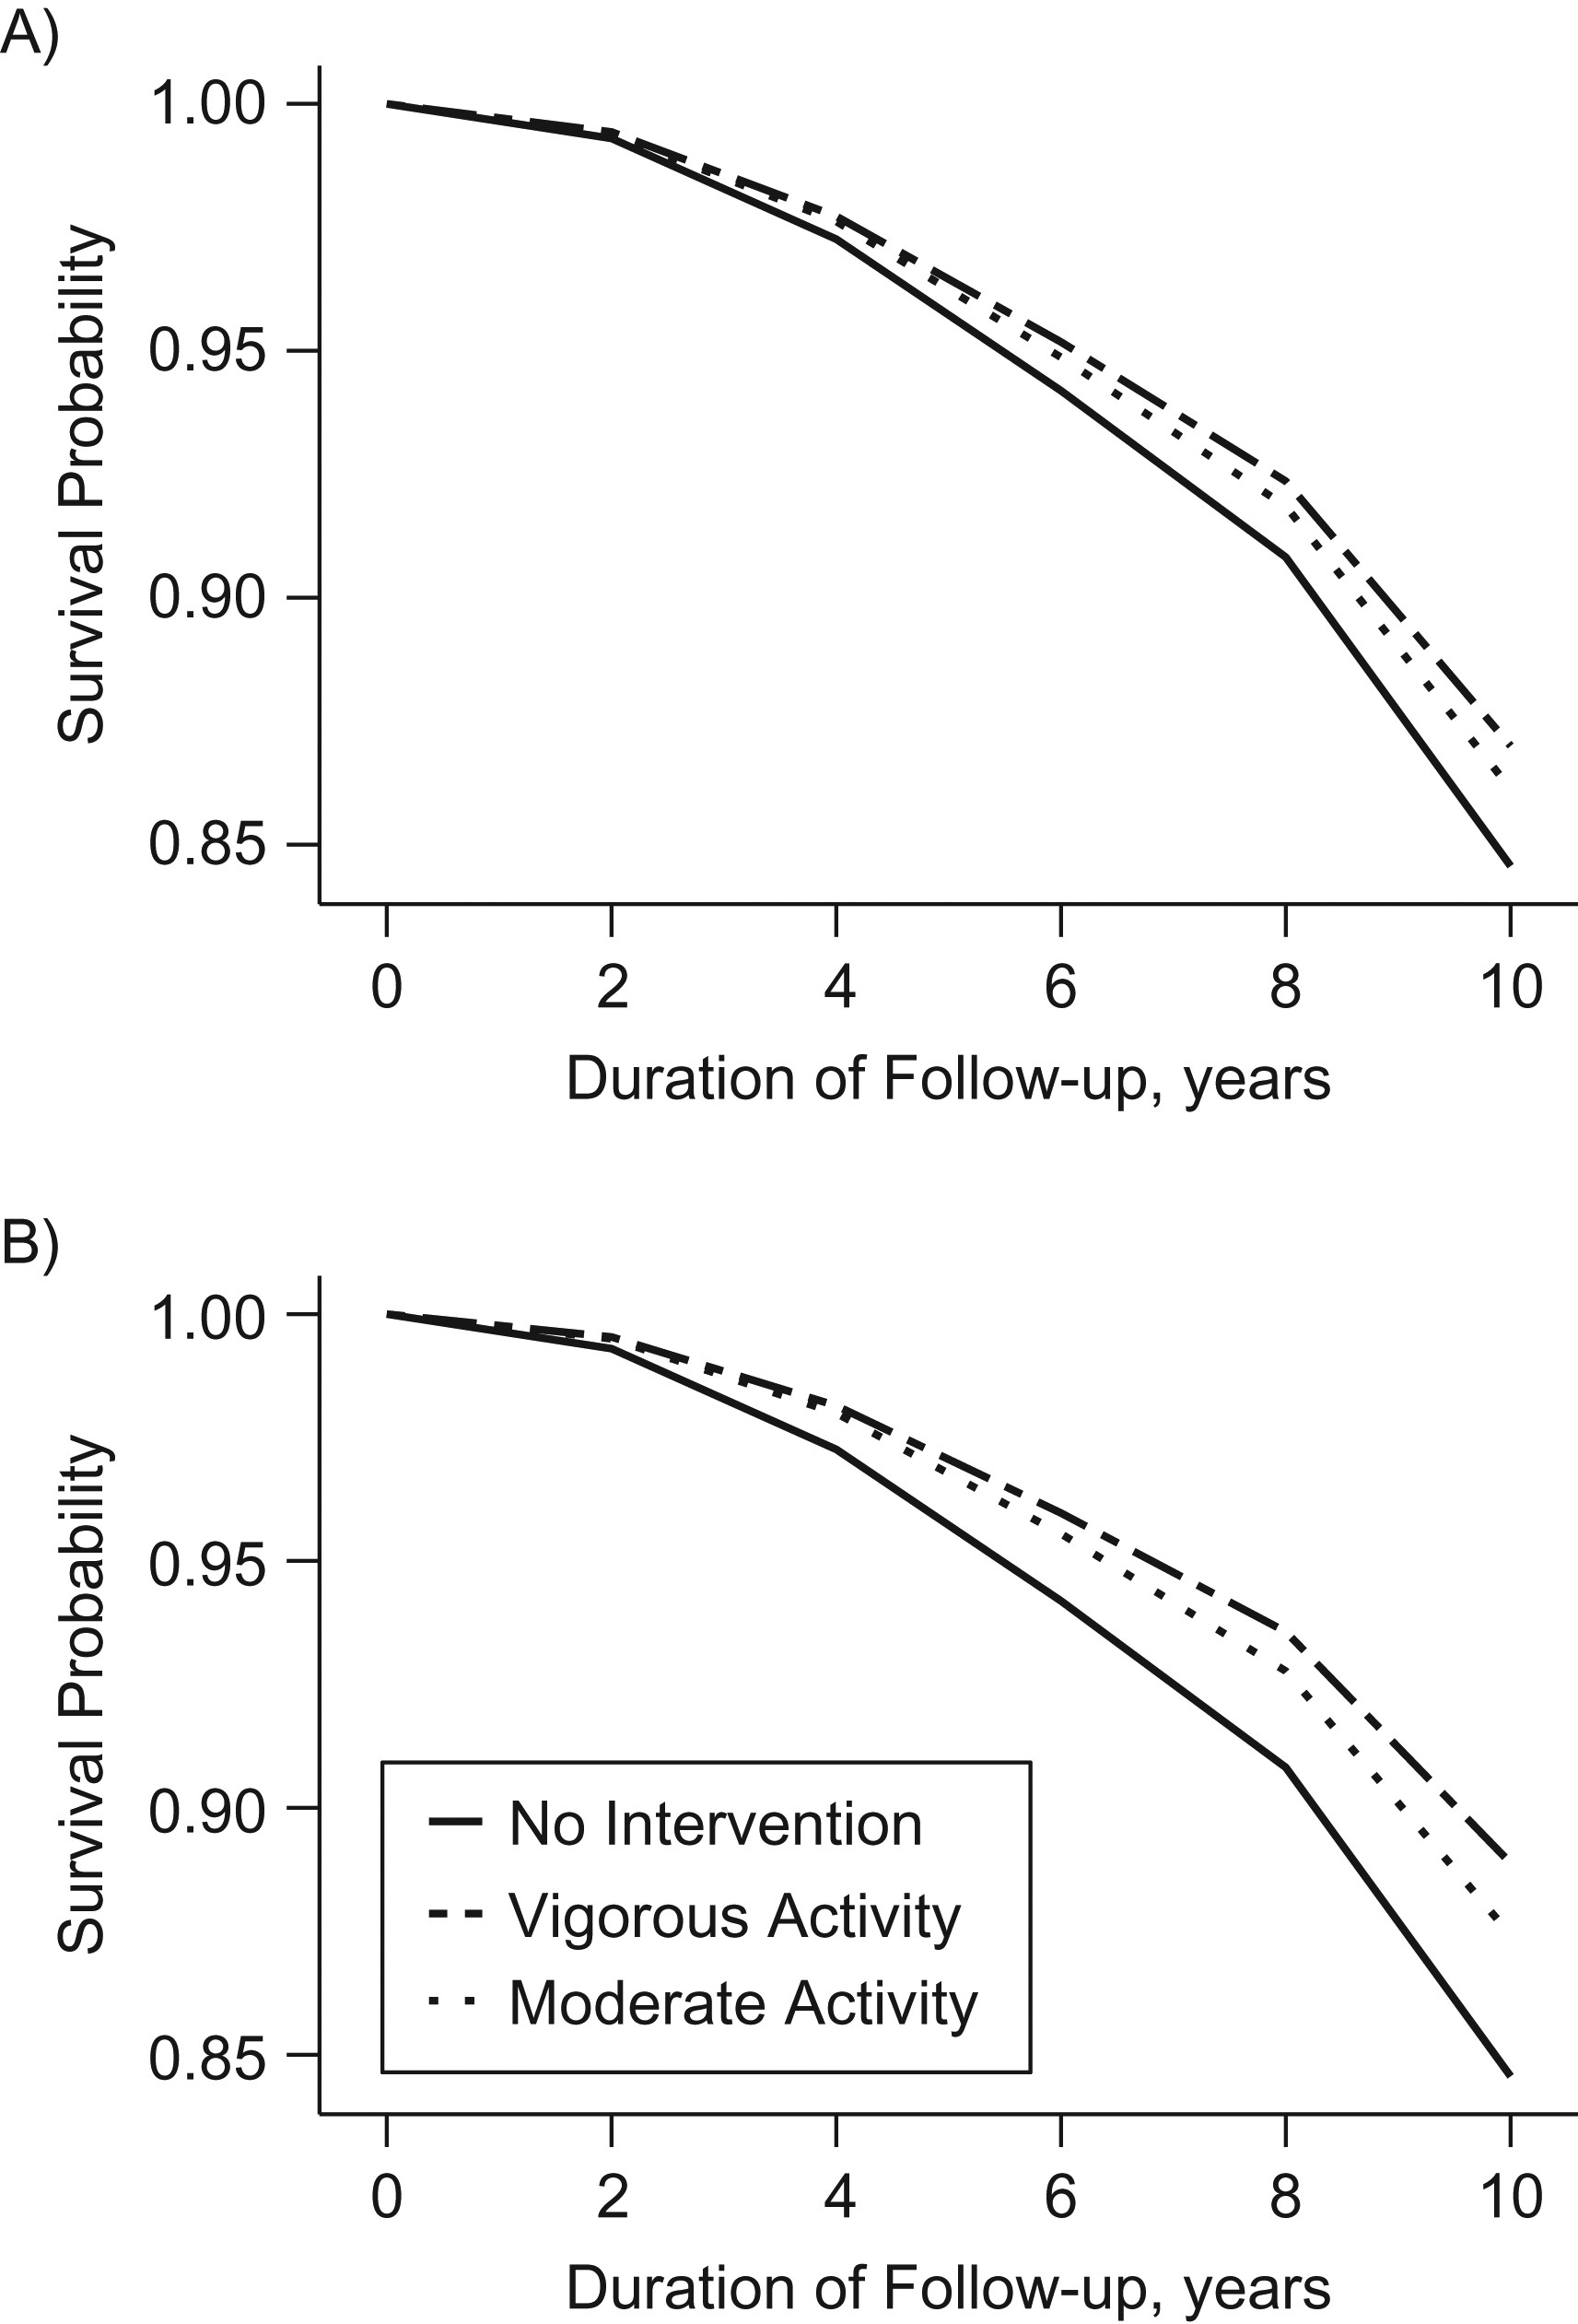
Parametric G-Formula
Overview
A model-based extension of standardization that estimates what would happen to outcomes if everyone followed a specific treatment strategy over time.
Rather than reweighting individuals (as in IPW), the g-formula models the outcome as a function of treatment and confounders, then simulates outcomes under different hypothetical interventions.
Handles time-varying confounding affected by prior treatment by iteratively predicting outcomes under specified exposure histories (e.g., full adherence vs no treatment).
Produces population-level estimates of risks or survival under competing strategies, which can be displayed as cumulative risk or survival curves.
Particularly useful for estimating the causal effect of sustained treatment or behavioural strategies over time.
Key Assumption(s)
Same as IPW: Consistency, Exchangeability, Positivity
Relevant Situations
Same as IP Weighting, but preferable:
When we are more confident about modelling the outcome than the treatment process.
When sufficient computational resources are available (more intensive than IPW).
Dickerman, B.A. et al. (2019) ‘Guideline-Based Physical Activity and Survival Among US Men With Nonmetastatic Prostate Cancer’, American Journal of Epidemiology, 188(3), pp. 579–586. Available at: https://doi.org/10.1093/aje/kwy261.

Slide 47
GF Ex.: Guideline-Based Physical Activity and Survival Among US Men With Nonmetastatic Prostate Cancer
Background
“The survival impact of adhering to current physical activity guidelines after prostate cancer diagnosis is unknown.”
“We therefore emulated a target trial of guideline-based physical activity interventions and 10-year survival among US men with nonmetastatic prostate cancer.”
Design
“We used observational data on 2,299 men in the Health Professionals Follow-up Study who were diagnosed with nonmetastatic prostate cancer from 1998 to 2010 and were free of conditions that might have precluded participation at baseline (first postdiagnostic questionnaire).”
“We estimated their survival under several guideline-based physical activity interventions starting at baseline and ending at the development of conditions limiting physical ability.”
“We adjusted for baseline and time-varying risk factors for death using the parametric g-formula.”
Results
“Compared with the observed 15.4% mortality risk, the estimated 10-year risks of mortality were 13.0% (95% confidence interval (CI): 10.9, 15.4) and 11.1% (95% CI: 8.7, 14.1) for ≥1.25 hours/week and ≥2.5 hours/week of vigorous activity, respectively, and 13.9% (95% CI: 12.0, 16.0) and 12.6% (95% CI: 10.6, 14.7) for ≥2.5 hours/week and ≥5 hours/week of moderate activity, respectively.”
Dickerman, B.A. et al. (2019) ‘Guideline-Based Physical Activity and Survival Among US Men With Nonmetastatic Prostate Cancer’, American Journal of Epidemiology, 188(3), pp. 579–586. Available at: https://doi.org/10.1093/aje/kwy261.

Slide 48
IPW vs Parametric G-Formula
Overview
Both methods are mathematically equivalent and, if models are correctly specified, should yield identical results.
In practice, both are often performed to check for model misspecification and strengthen confidence in causal estimates.
Inverse Probability Weighting
Best used when we are more confident about modelling the treatment process than the outcome.
Creates a weighted pseudo-population where treatment is balanced across measured covariates.
Works well when the treatment assignment mechanism (e.g., prescribing or referral decisions) is clear and can be modelled accurately.
Less computationally intensive compared to the parametric G-Formula.
Example: Evaluating the effect of anticoagulant switching when we trust our model of the prescription process but the outcome process (e.g., stroke or bleeding) is complex or uncertain.
Parametric G-Formula
Best used when we are more confident about modelling the outcome process than the treatment assignment.
Simulates outcomes under different hypothetical treatment strategies, using fitted outcome and covariate models.
Works well when outcomes and time-varying confounders can be modelled realistically over time.
More computationally intensive compared to Inverse Probability Weighting.
Example: Estimating the long-term reduction in cardiovascular events if all eligible patients maintained blood pressure below 130 mmHg, where the outcome process (BP → CVD risk) is well understood and can be modelled accurately using established risk equations.

Slide 49
Case Studies from North Central London
Section 6
Notes:
Aiming to identify a holistic set of barriers to applying causal methods (cultural, data etc.)

Slide 50
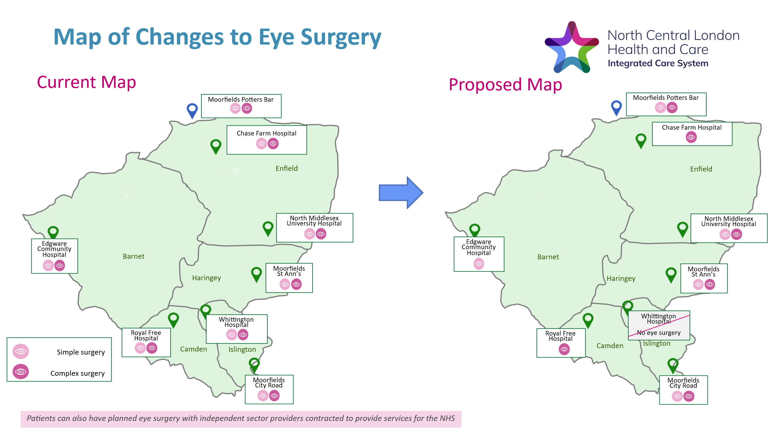
Hub Model of Care for Ophthalmology
A plan to concentrate simple and complex elective eye surgeries into separate hospitals to increase safe, sustainable, and equitable care
Ophthalmology has recently transitioned to a hub model of care.
Care providers transition to only having surgical services that accommodate their strengths and capabilities.
Aimed to improve efficiency, reduce eye surgery waiting times, and reduce clinical harm.
Separate hubs for simple and complex eye surgeries have been stablished in NCL.
Notes:
Plain slide with subhead and bullets

Slide 51
Study 1: Hub Model of Care for Ophthalmology
Initial Question from Stakeholder
Has transitioning to the hub model of care for ophthalmology surgery services improved outcomes and efficiency, and did care remain equitable?
Proposed Study Design
Interrupted Time Series
Causal Contrast
Measures of outcomes before and after the implementation of the hub model of care (Feb 2024)
Factors to Control For
Seasonality, COVID-19 effects, rollout of any other community care interventions, hospital infrastructure changes, industrial action, system failures etc.
Outcomes
Safe Care
a) Reducing clinical harm (posterior capsular complications)
b) Improving vision after cataract surgery (Best Corrected Visual Acuity [BCVA] >6/12 at 2-8 weeks)
Sustainable care
c) Increase elective care activity (absolute numbers of treated patients)
d) Reduce patients waiting for surgery (proportion of patients waiting)
e) Improved theatre utilisation/efficiency
Equitable care
f) Reduction in variation in access to care (subgroup analysis of waiting list metrics)
g) Reduction in variation in elective care activity (subgroup analysis of activity metrics)
Notes:
- Note assumptions

Slide 52
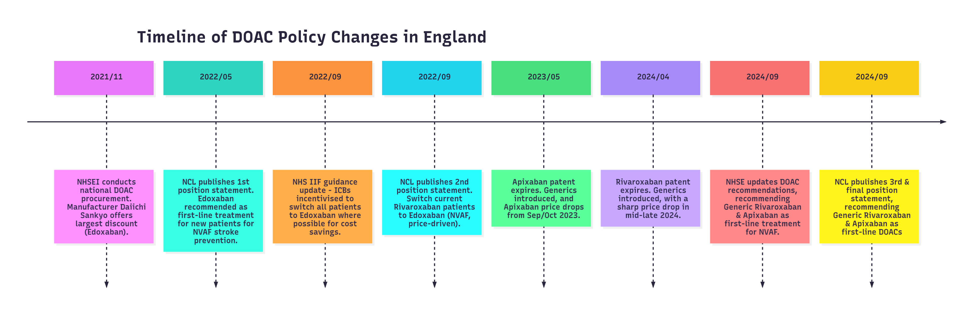
DOAC Prescription Policy Changes
A policy shift to Edoxaban for patients with non-valvular atrial fibrillation to lower DOAC acquisition costs
Notes:
Plain slide with subhead and bullets

Slide 53
Study 2: DOAC Prescription Policy Changes
Initial Questions from Stakeholder
To what extend did the change in policy for DOAC prescriptions
a) Affect patient outcomes and service uilisation? b) Affect diagnosis rates of NVAF and uptake of DOACs?
In addition, as there are no results from trials at the moment, what is the comparative effectiveness between common DOACs?
Proposed Study Design
For ICB level effects: Interrupted Time Series
For individual level effects: G-Methods (Inverse Probability Weighting and/or Parametric G-Formula)
Causal Contrast
Measures of outcomes before and after the change in DOAC prescription policy (May-Sep 2022)
Effect of adhering to treatment (Edoxaban vs. Rivaroxaban vs. Apixaban) on clinical outcomes
Factors to Control For
Seasonality, COVID-19 effects, rollout of any other community care interventions, hospital infrastructure changes, industrial action, system failures etc.
Prescription history of patients, prior history of adverse events (e.g., stroke, MI, major bleeding), comorbidities, sociodemographics
Outcomes
ICB level measures, for example:
a) No. of adverse events associated with DOACs due to switching
b) Additional attendances at GP or A&E due to switching
c) No. of NVAF diagnoses
Patient level measures (head-to-head comparison)
a) No. of cardiovascular related adverse events
Notes:
- Note assumptions

Slide 54

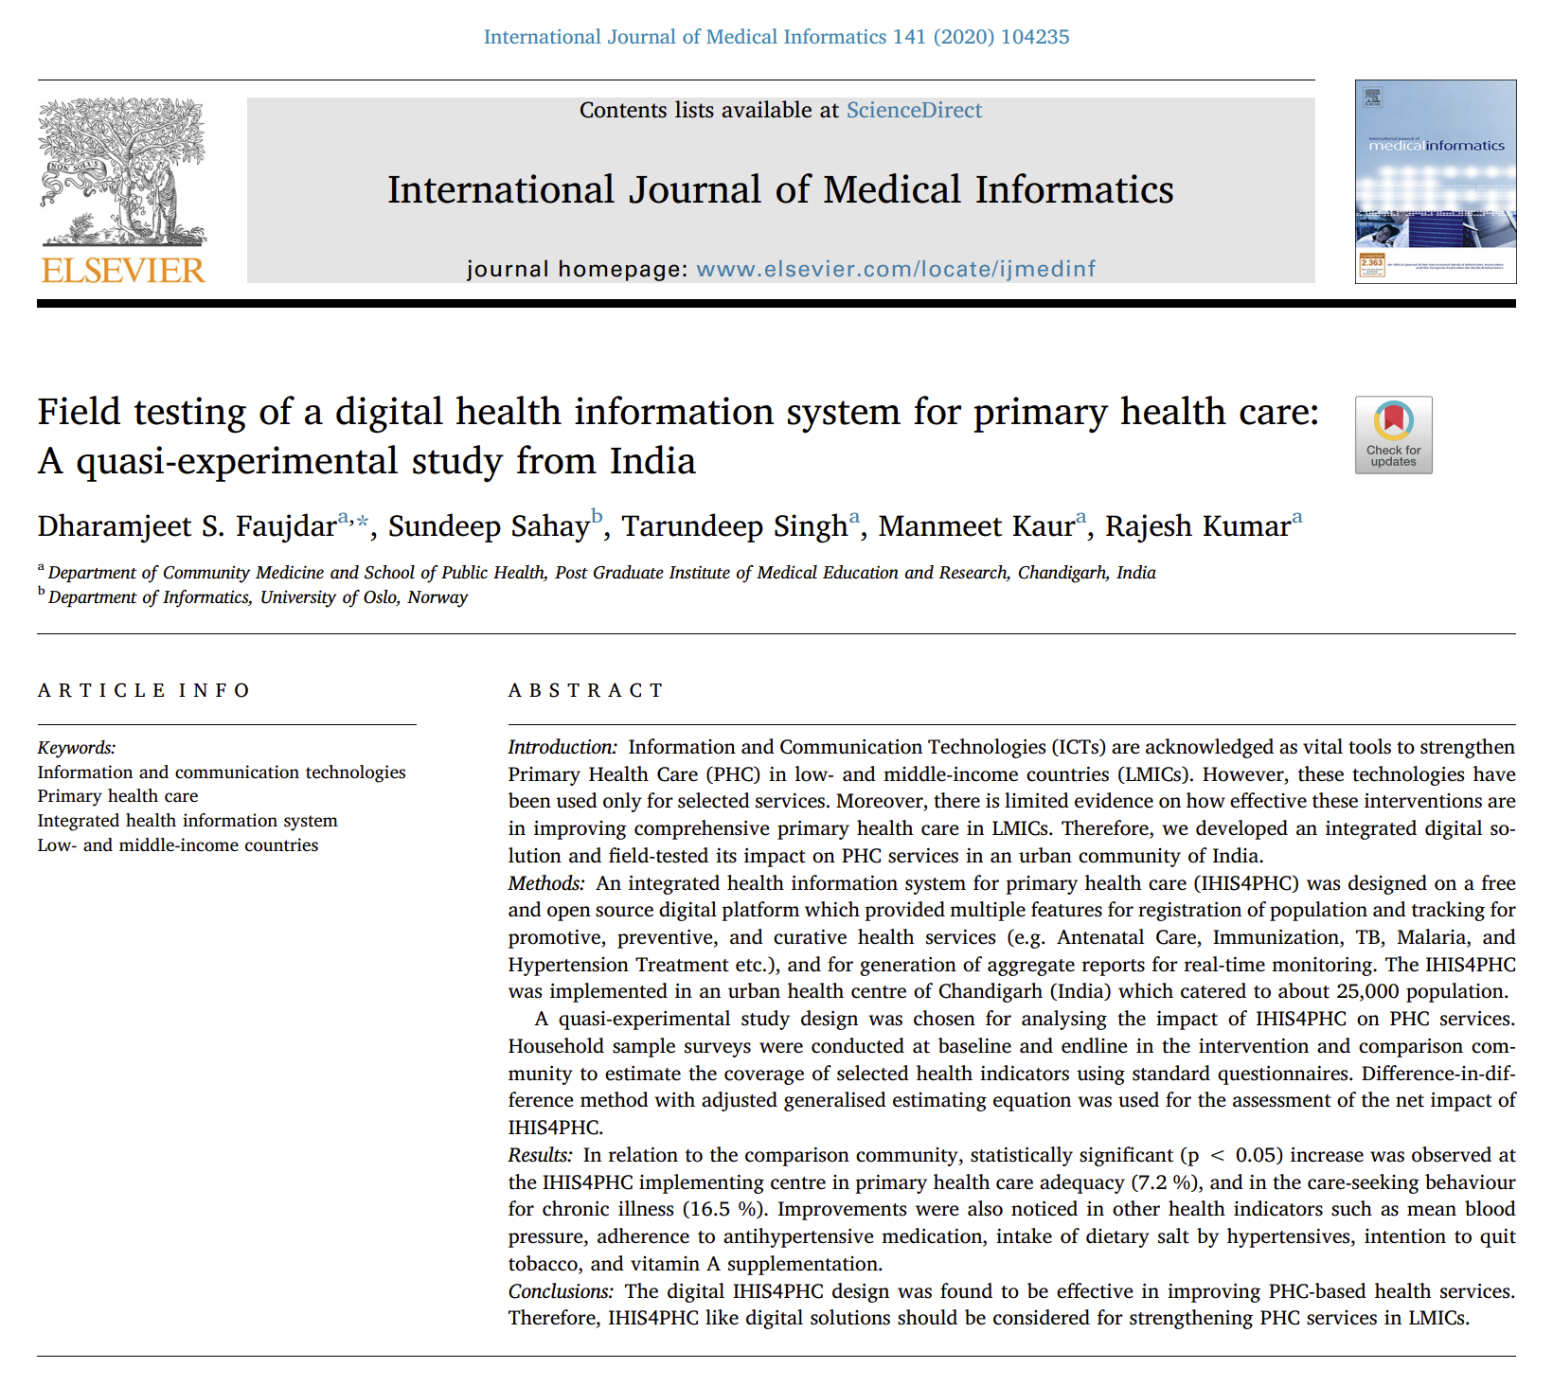
Potential Applications for Digital Interventions
Notes:
Considering that these methods are powerful tools to invest further into digital tools
Digital interventions being piloted in NCL:
risk strat to inform proactive care list the C-LTCS
risk strat and segmentation to inform triaging
tools to schedule procedures like surgical lists
tools to prioritise people on waiting lists
scribes to save clinician's time
image analysis to support diagnostics

Slide 55
Wrap-Up
Section 5

Slide 56
Key Takeaway Messages
Applying causal methods using observational data and employing target trial emulation can:
Help quantify the effect of interventions and service changes
Help quantify the uncertainty we have in our estimates
Estimate the return on investment for interventions (both hypothetical and historical)
Help us be more transparent about the assumptions underlying our effect estimates
Drive higher quality decisions using data
However, given the added time required to apply such methods, consider them to be more appropriate when:
There are large costs associated with a new intervention
We are debating whether to continue investing into a pre-existing intervention
There is also room to consider potential collaborations between the NHS and academia.
Also stay tuned for my handbook on causal methods as a reference for future work!
Notes:
Consider that this is more appropriate in situations where there are large costs associated with the intervention

Slide 57
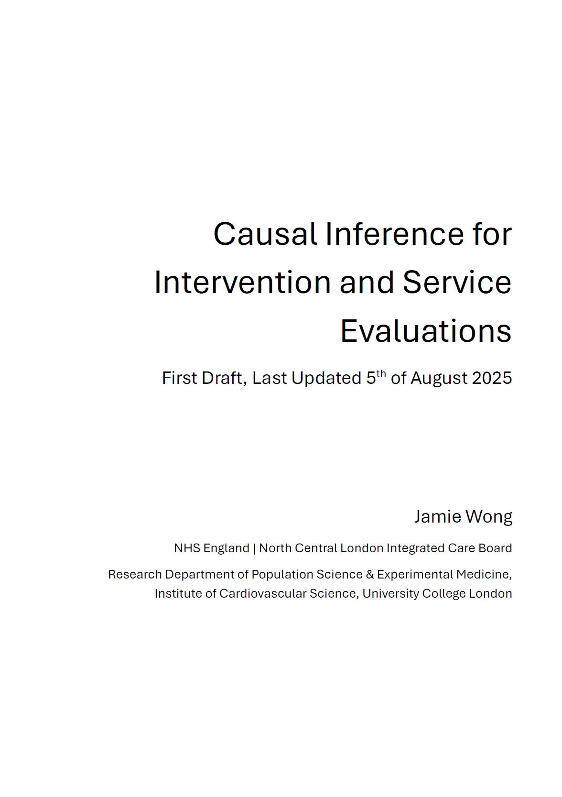
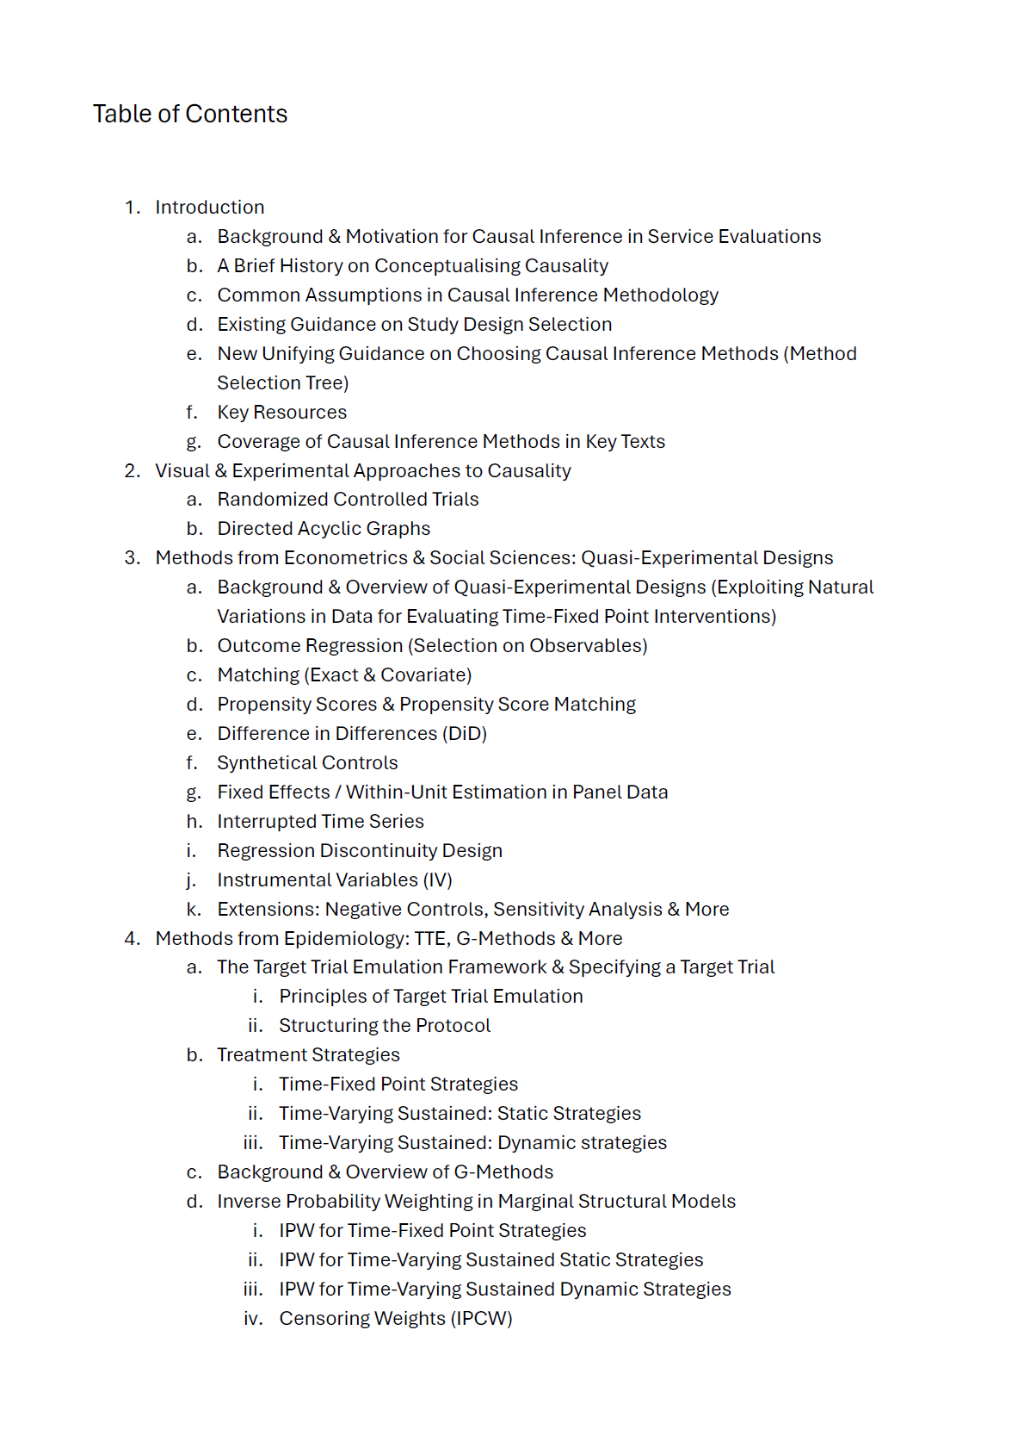
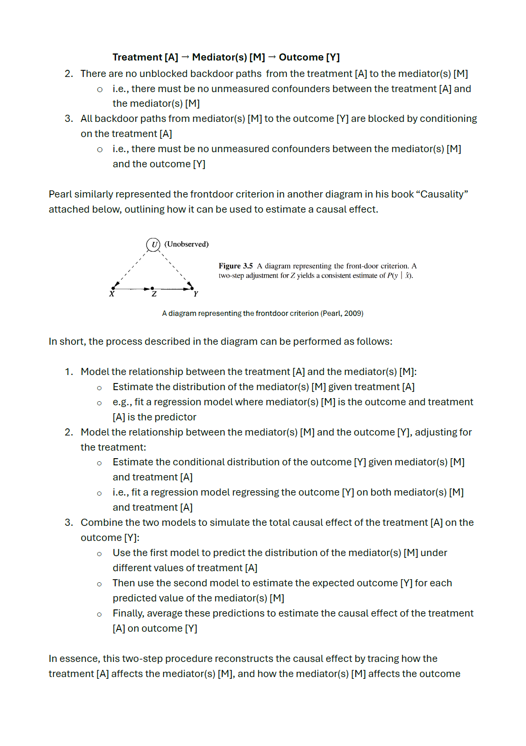
Causal Methods Handbook
Notes:
Seek to address other barriers in the application of causal methods within the NHS as part of the internship (to be added as a chapter here)
Problem scoping, time frames, data quality

Slide 58
Causal Methods Handbook
To be hosted on Github alongside case studies from NCL ICB:
https://github.com/nhsengland/causal-handbook
To be completed by mid-December 2025 (No content is currently uploaded to the Github repo)

Slide 59
Email
laichunjamie.wong@nhs.net
jamie.wong@ucl.ac.uk
NHS Supervisors
Jonny Pearson (NHS England)
Emily Baldwin (NCL ICB)
UCL Supervisors
Dr Michalis Katsoulis
Prof Manuel Gomes
Dr Sophie Eastwood

